Slide 1

Operationale und analytische Workloads in der Cloud auf Basis quelloffener Telematik Daten
Sebastian Moehn
IBM Cloud Data Services - CTP Europe

Slide 2
Introduction: Telematics data from NYC Taxi

Slide 3
What Data is it?
A database of every cab ride taken in New York City in 2013
Assembled by the city’s Taxi and Limousine Commission
Approximately 173 million individual rides (50GB)
Initially released on March 18 to a New York City data analyst named Chris Whong, who requested the information under New York State’s Freedom of Information Law.
The database catalogs the times, geographic coordinates (pickup, dropoff), fares, tips, passengers, ratings, etc. of each ride
Notes:
http://www.andresmh.com/nyctaxitrips/

Slide 4
What do we want to demonstrate?
Real-Time data ingestion to an operational NoSQL data store (IBM Cloudant)
Real-Time, mobile-ready, data querying via Geo-Indexing (IBM Cloudant)
Data transformation (ETL) from NoSQL to Relational Format (IBM Cloudant + IBM dashDB)
In-database Analytics with R (IBM dashDB)
Find answers and insights from the data (IBM Watson Analytics)

Slide 5












What do we want to demonstrate?
IBM Cloudant
IBM dashDB
Watson Analytics
Trans-
formation
Gateway
NoSQL store
RDBMS
Exploration
Real-time access
In-database Analytics
70
Predective Analytics
Onboard Unit
Time
Location
Distance
Passengers
Fares
Rating
…
(SaaS)
IBM Bluemix (PaaS)
IBM SoftLayer (IaaS)

Slide 6
Use Cases
Mobile Web Application for customers
Ad-Hoc Data Analytics from operational data (e.g. usage, etc.) for Lines of Business
Development of short period marketing application (e.g. Worldcup, etc.)
Trial & Error development with fast cloud services

Slide 7
Explanation: The products

Slide 8
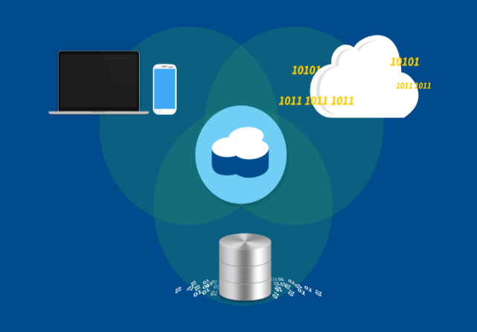





IBM Cloudant
Operational Data Store based on Apache CouchDB
NoSQL Document Database (schema less)
Simple and well-defined HTTP API
Fully Integrated:
Replication & Sync
MapReduce for Real-time Indexing
Full-Text Search
GeoSpatial
Multi-tenant and dedicated-tenant clusters or on-premise
Monitoring, administration & development Dashboard
Mobile Devices
Cloud
Delivery
Big Data
Cluster A
Cluster B
Pull
Sync
Push
Sync
Sync

Slide 9



IBM dashDB
Data warehouse and analytics as a service on the cloud
Build More
Grow More
Know More
Simple, up and running in minutes with rapid cloud provisioning
No infrastructure investment provides true business agility
Grow faster by focusing on your business, not the business of data warehousing
Built-in Performance with In-memory technology delivers answers faster
Built for Analytics to help you understand your data and business
In-Database Analytics for greater efficiency and performance
Compatible with Advanced Tooling like R and Watson Analytics
dashDB keeps data warehouse infrastructure out of your way

Slide 10
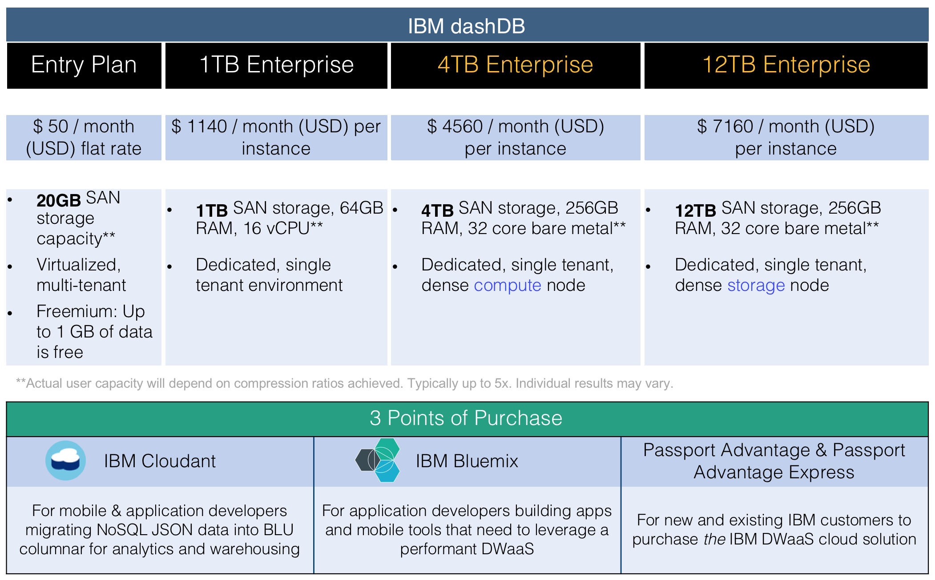

Slide 11
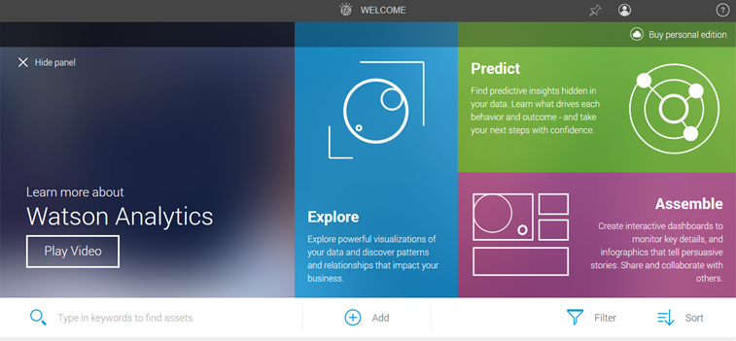






Watson Analytics
Watson Analytics is:
Cloud Based Agility
Self-Service for Business Users
Data Discovery
Guided Analytic Discovery
Natural Language Dialogue
Data Accesss and Refinement
Reporting and Dashboarding
Mobile-ready
Visual Storytelling
Mobile First
Analytics can make a difference in many ways
Marketing
Sales
Finance
IT
Operations
HR

Slide 12
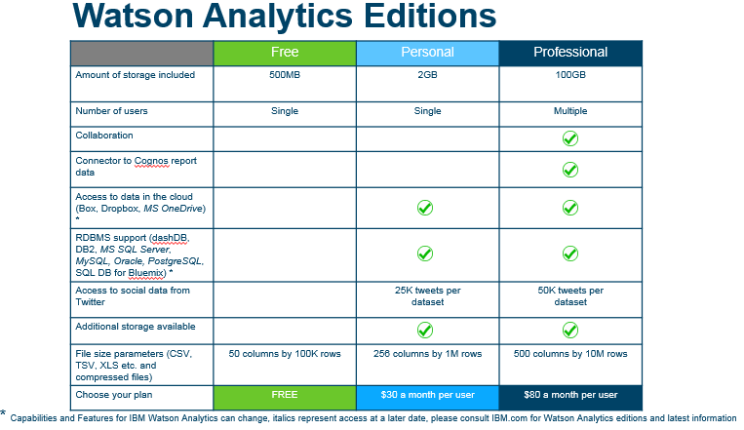

Slide 13
The combination of cloud solutions
Cloudant
dashDB
Watson Analytics
Highly scalable, reliable, operational database
Schema-less datastore
Easy data synchronization and replication
Mobile integration trough IBM Cloudant Sync
Available as Multi-Tennant pay-as-you-go, to Dedicated Cluster and on-premise
Rapid deployment of large scale data warehouses
Enables scaling of both volume and processing speed
Unified architecture that enables hybrid data processing, on-premise & in the cloud
In-database analytic capabilities for the best analytic performance
Cloud-based predictive & cognitive analytics discovery platform
Designed for business use
Integrated social collaboration
Freemium to enterprise versions

Slide 14

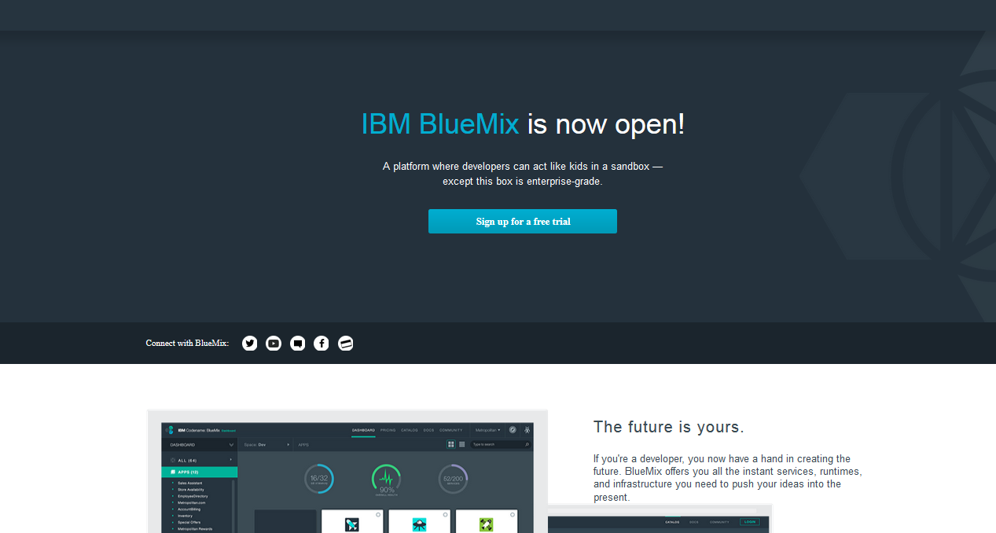


IBM Bluemix
By dramatically increasing the speed at which new apps can be prototyped and deployed, and by which new services and features can be added, Bluemix can be central to any organization’s innovation strategy
About Bluemix
Bluemix services include:
Run apps in any language
Built on open standards
Integration services to systems of record
Designed for mobile
Provides DevOps services
DevOps
Big Data
Mobile
Cloud Integration
Security
Internet of Things
Business Analytics
Database
Web and application
Deploy and scale
new applications and services with infrastructure services from IBM SoftLayer.
Code with confidence
knowing IBM’s cloud platform is built on a foundation of open standards.

Slide 15
Demo

Slide 16
Demo (Backup Slides)

Slide 17
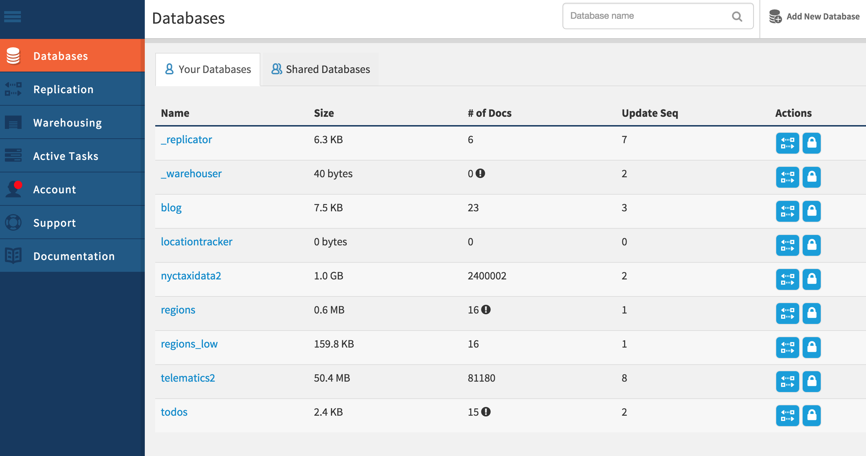

Slide 18
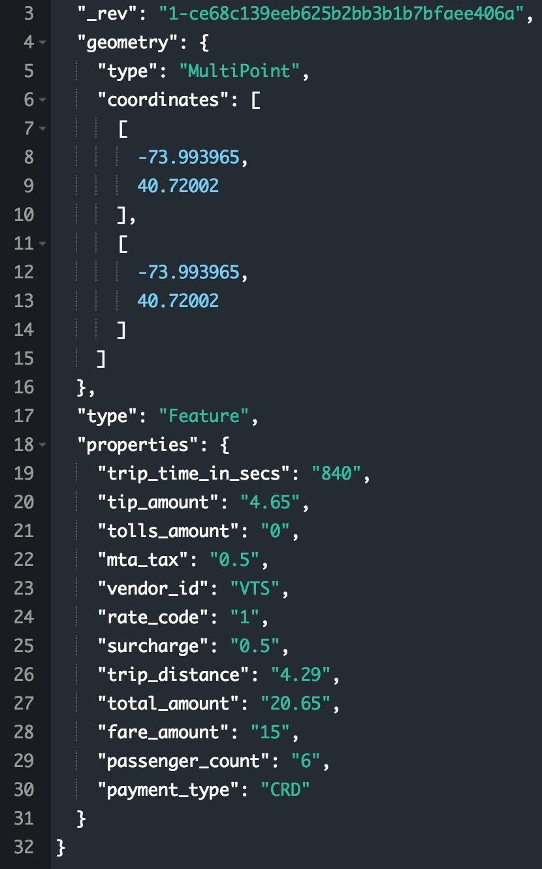
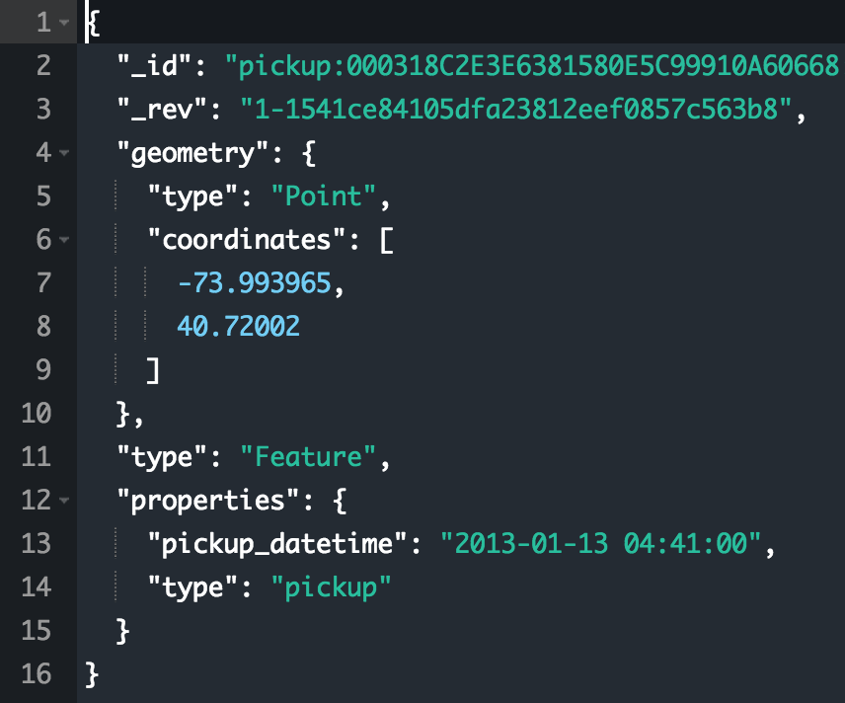

Slide 19
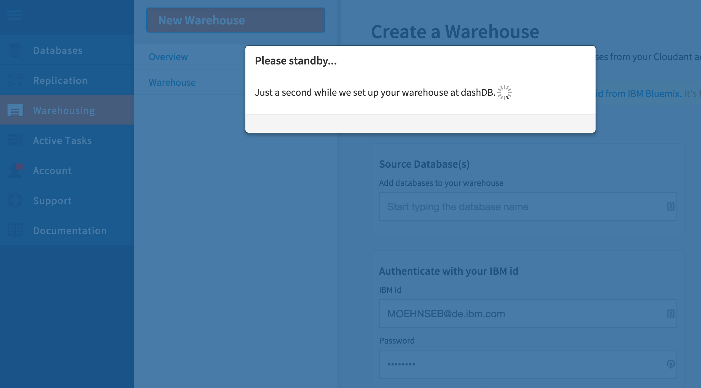

Slide 20
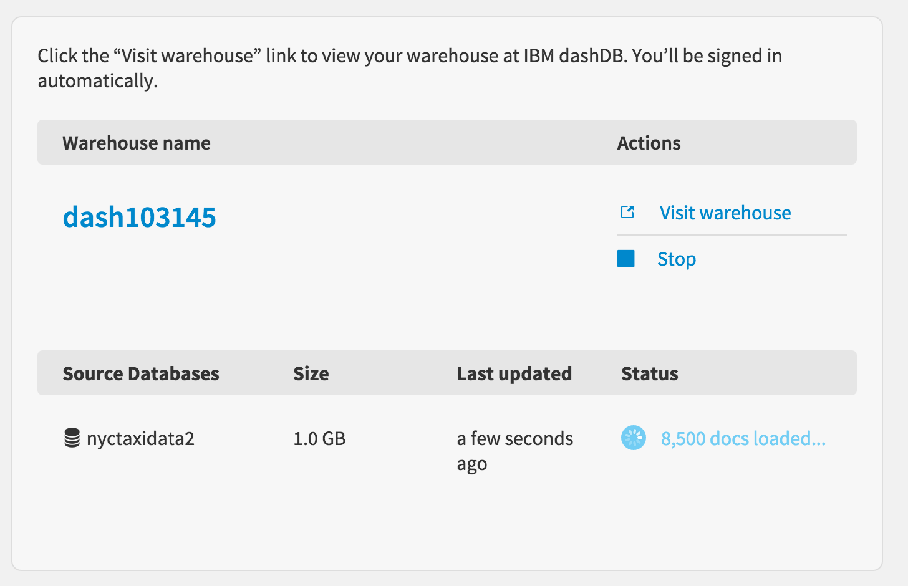

Slide 21
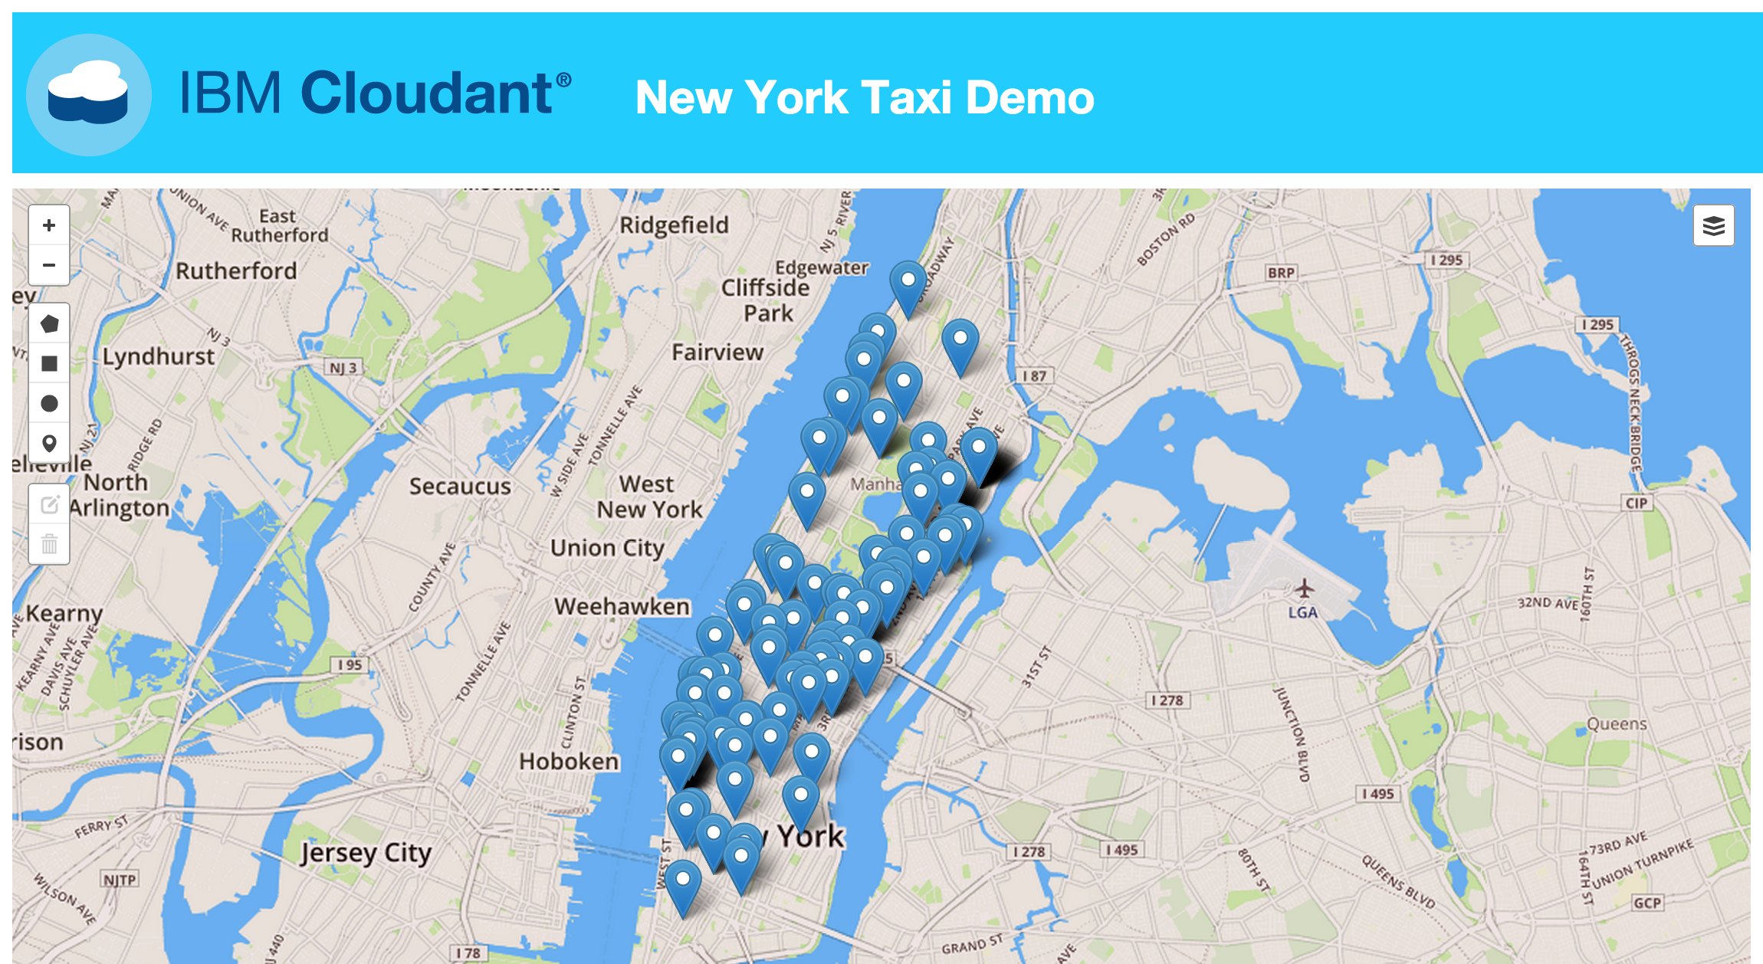

Slide 22
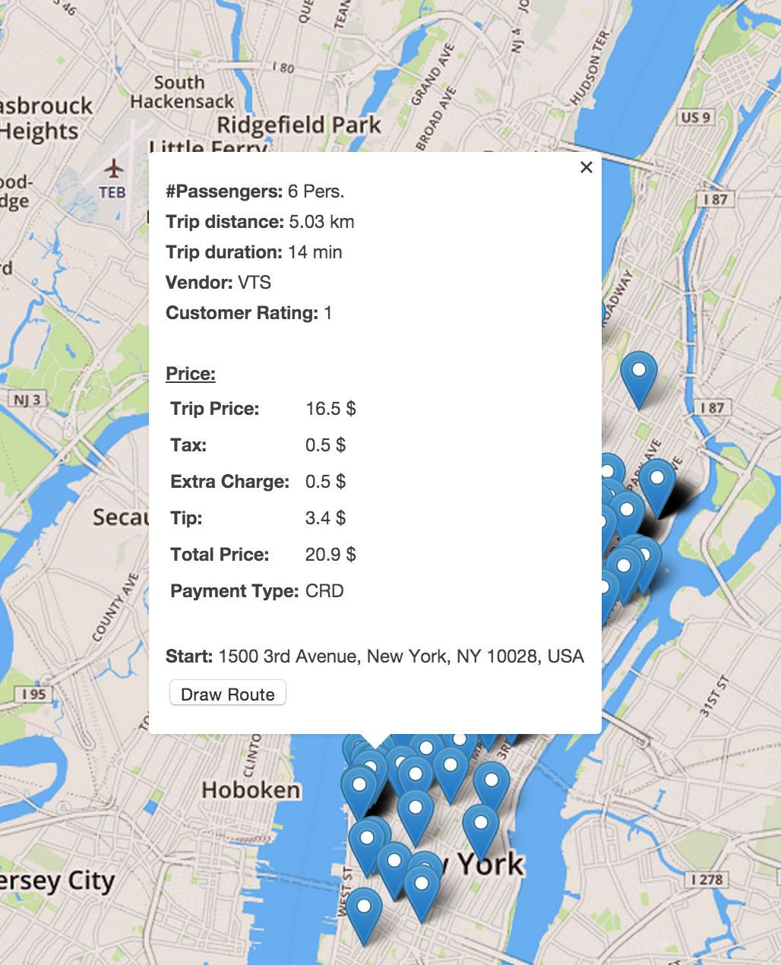
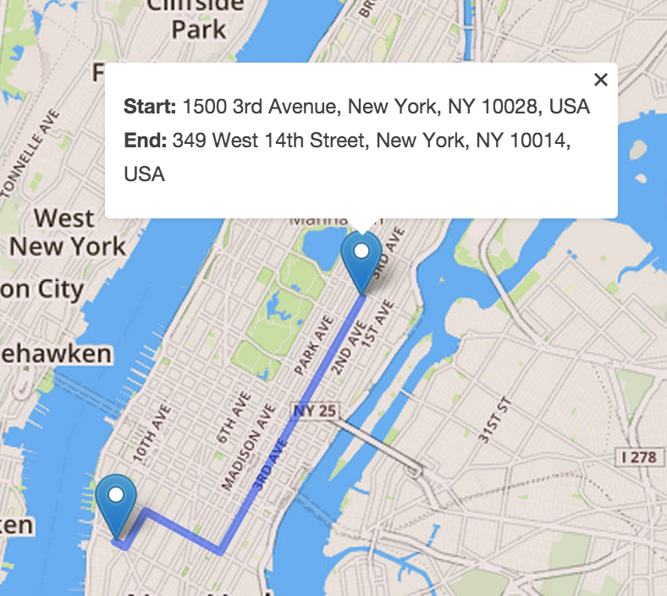

Slide 23
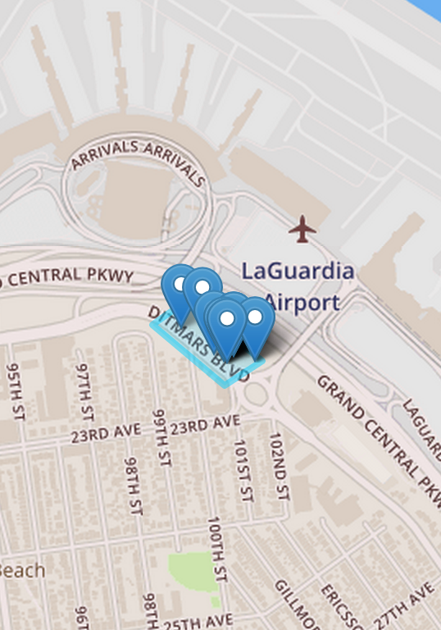
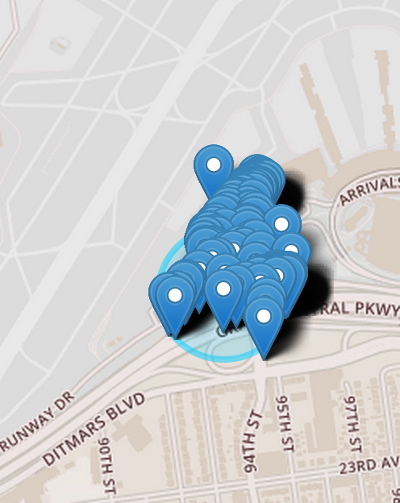

Slide 24
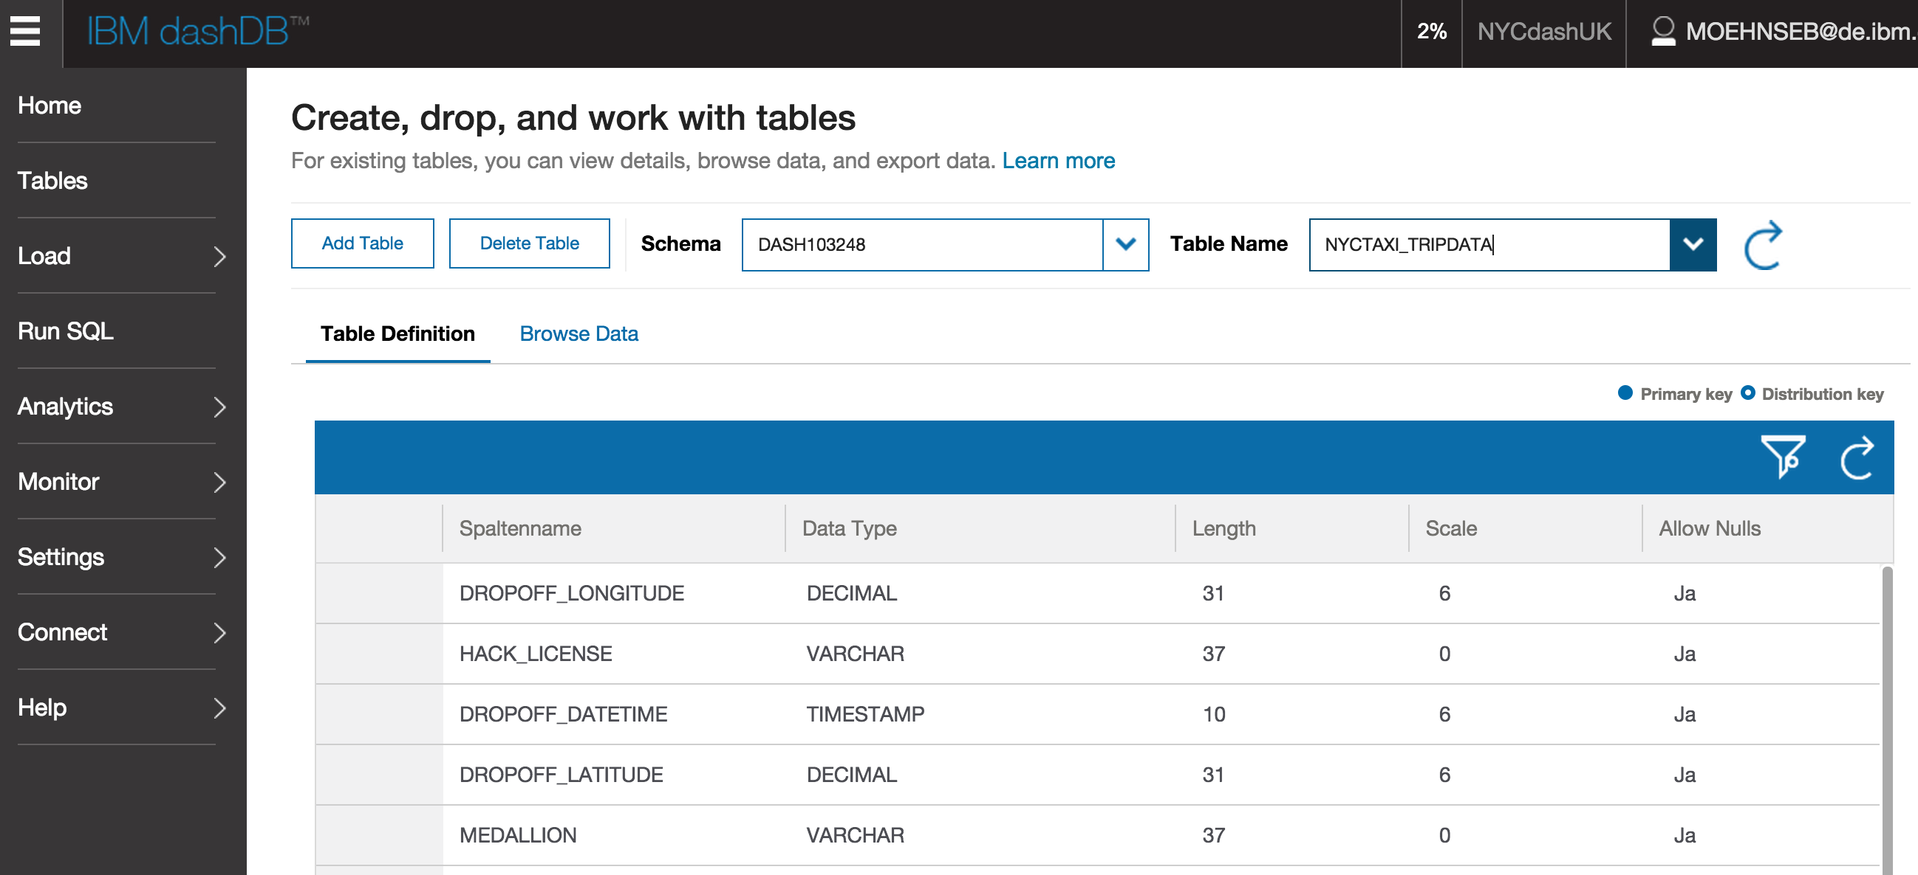

Slide 25
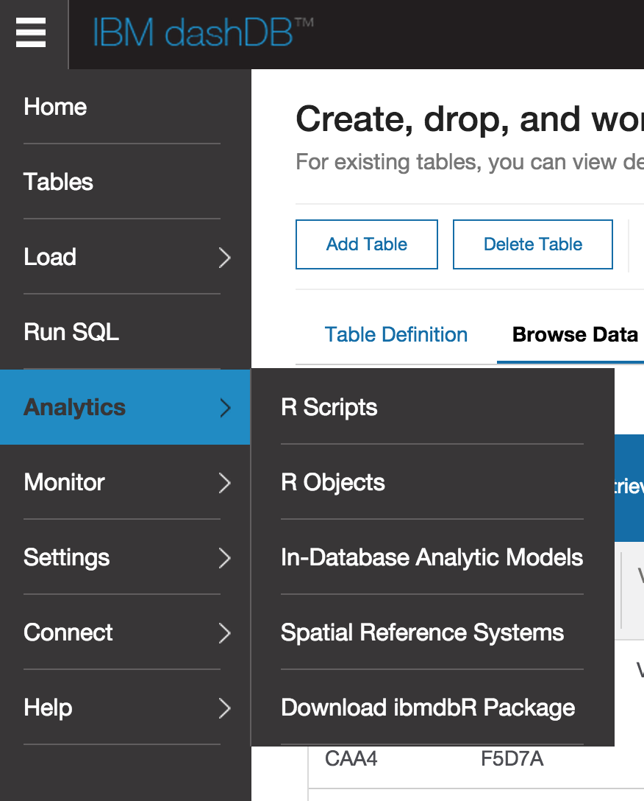
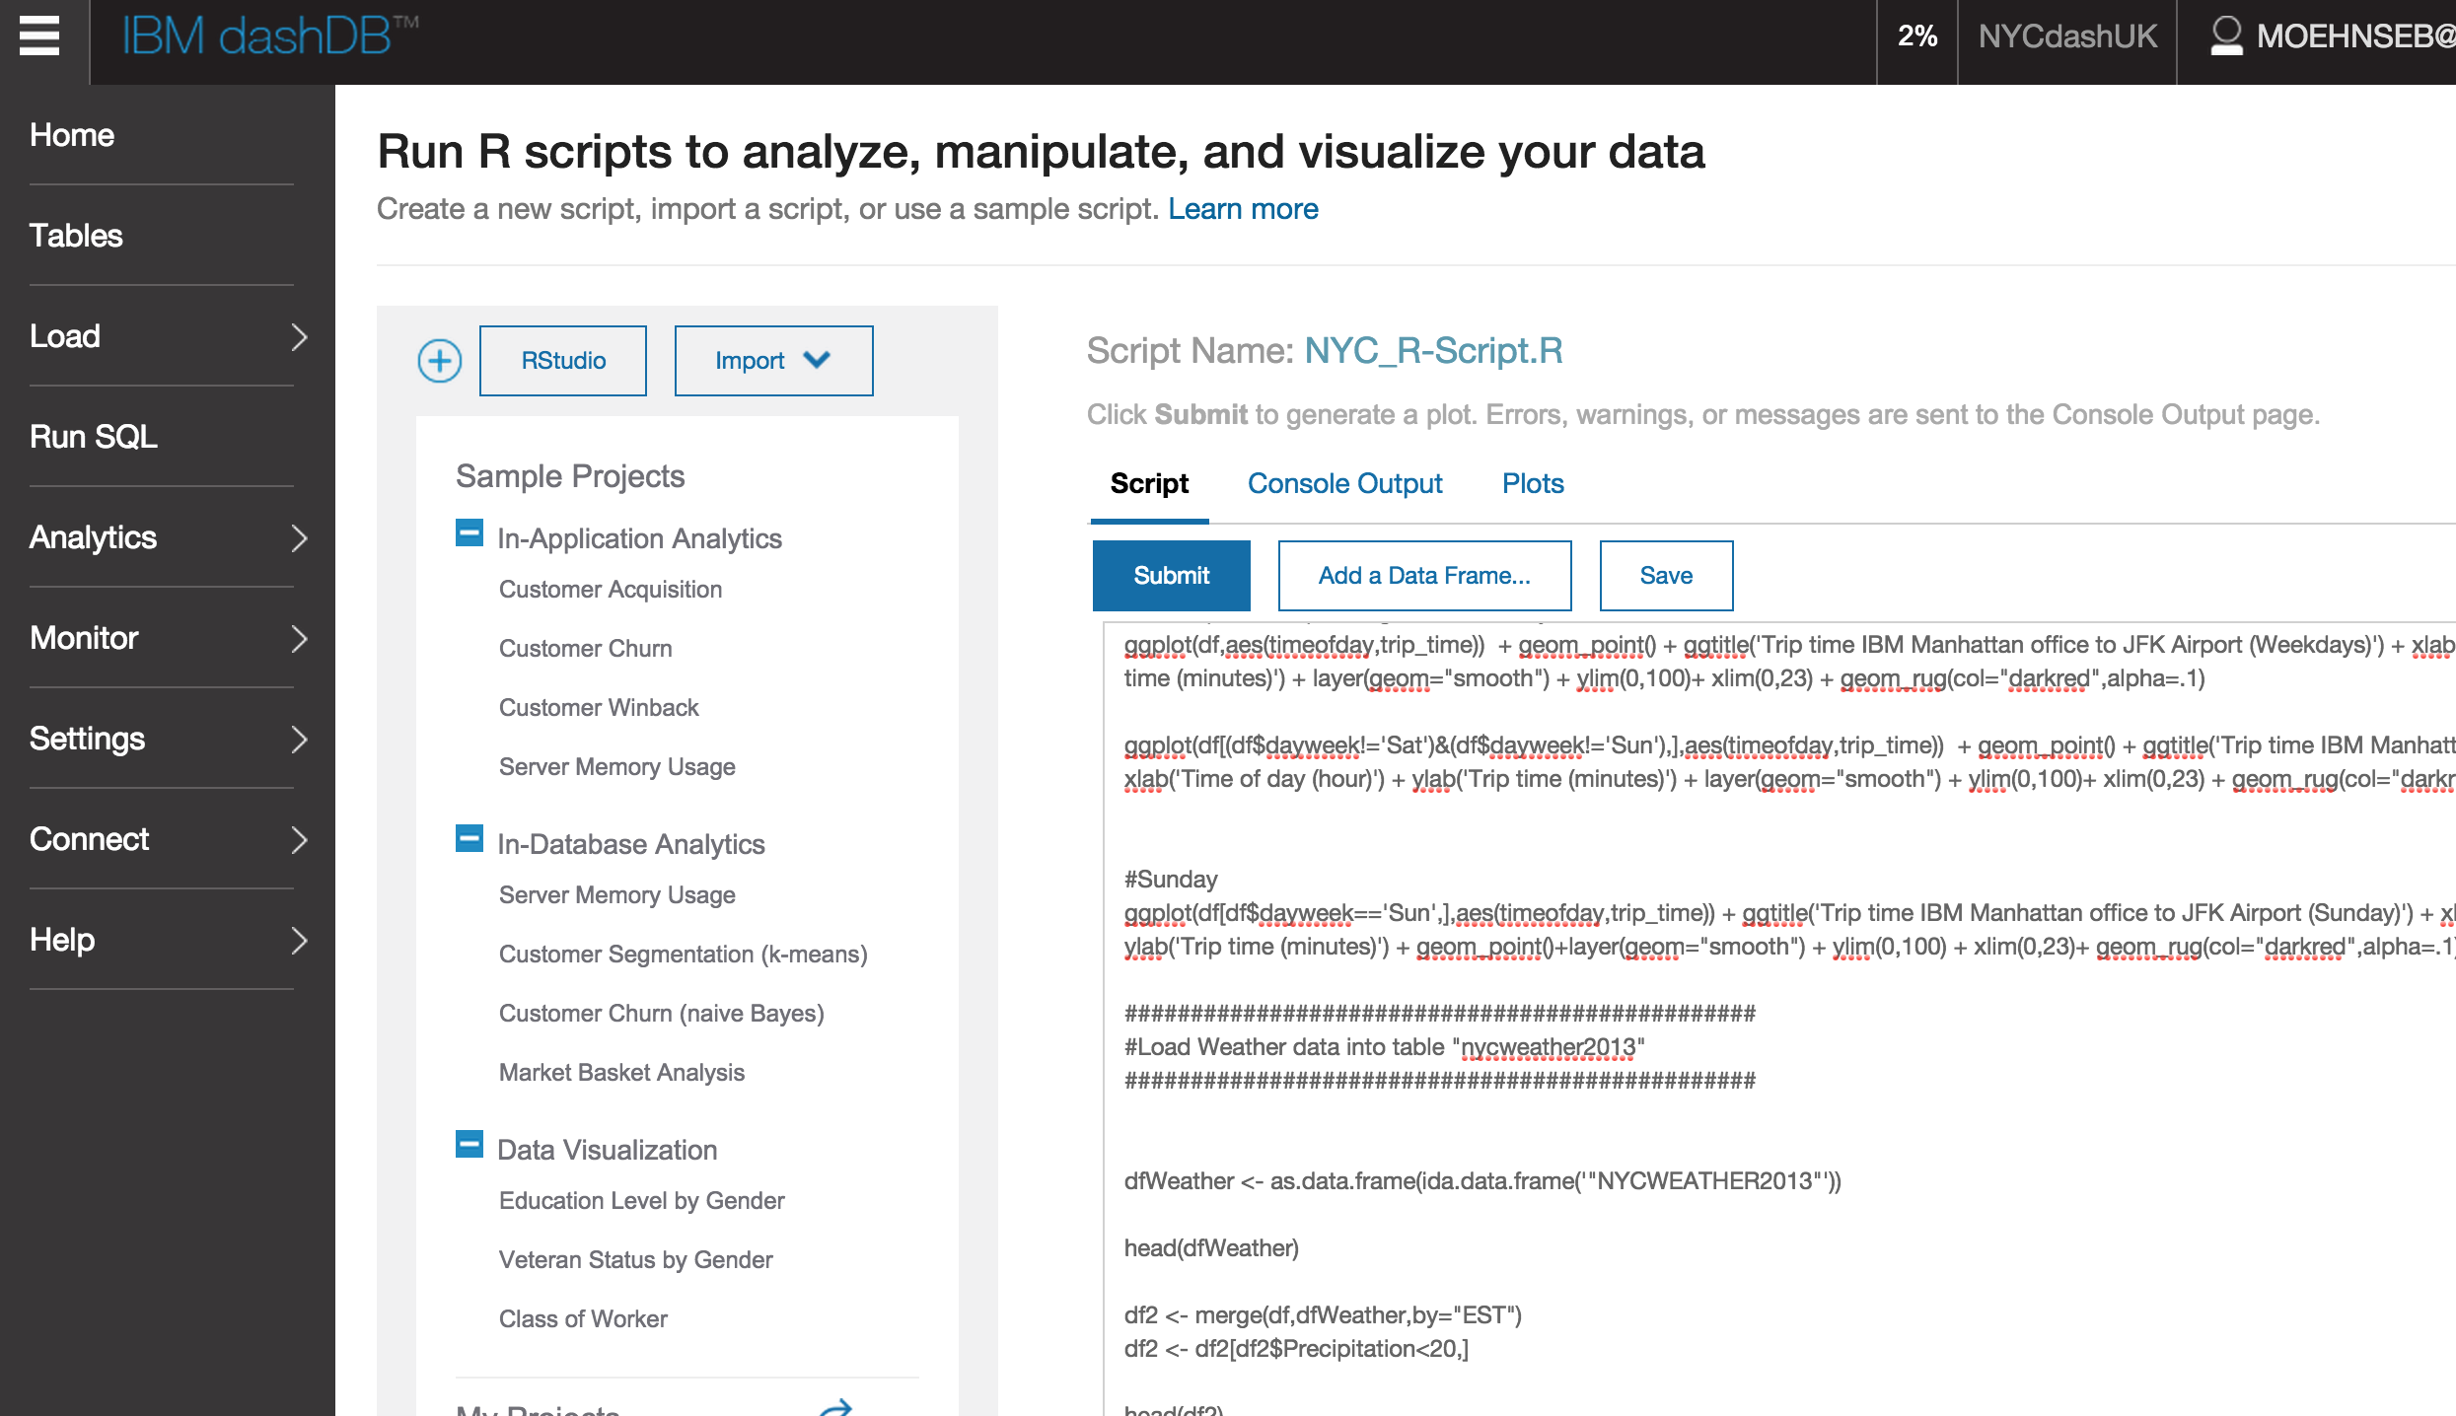

Slide 26
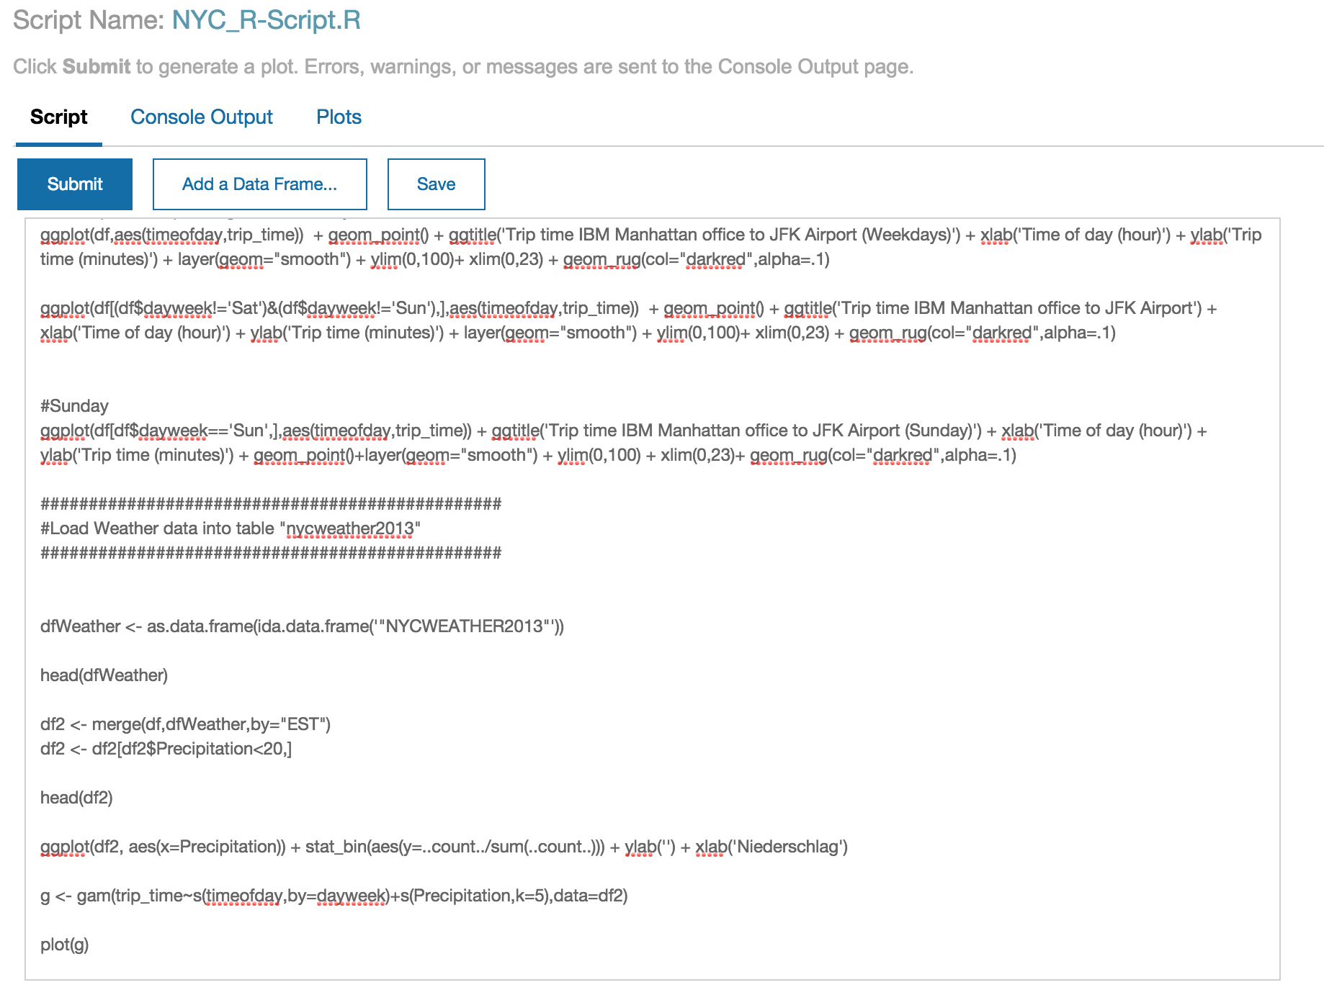

Slide 27
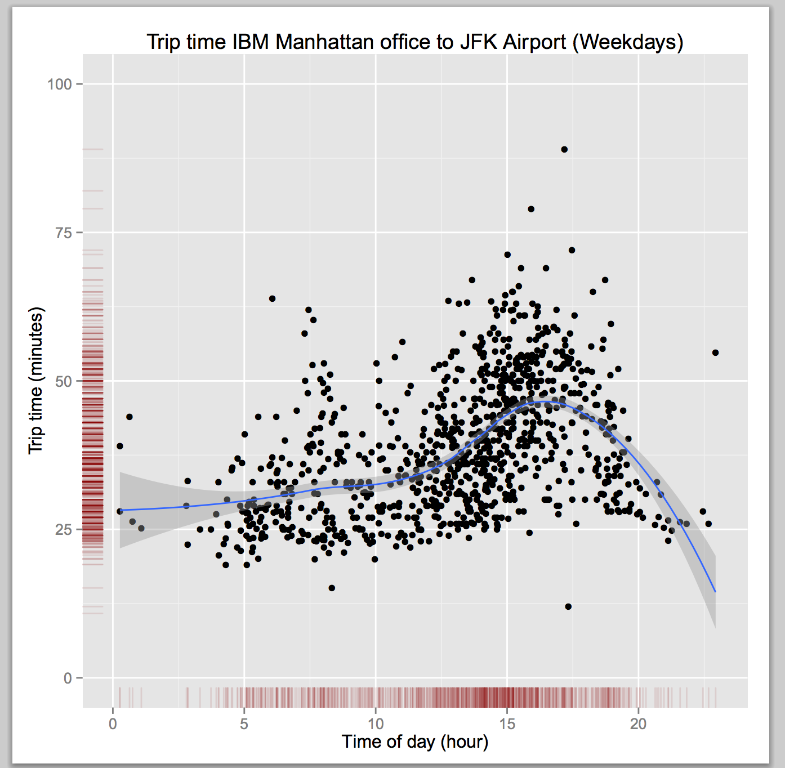
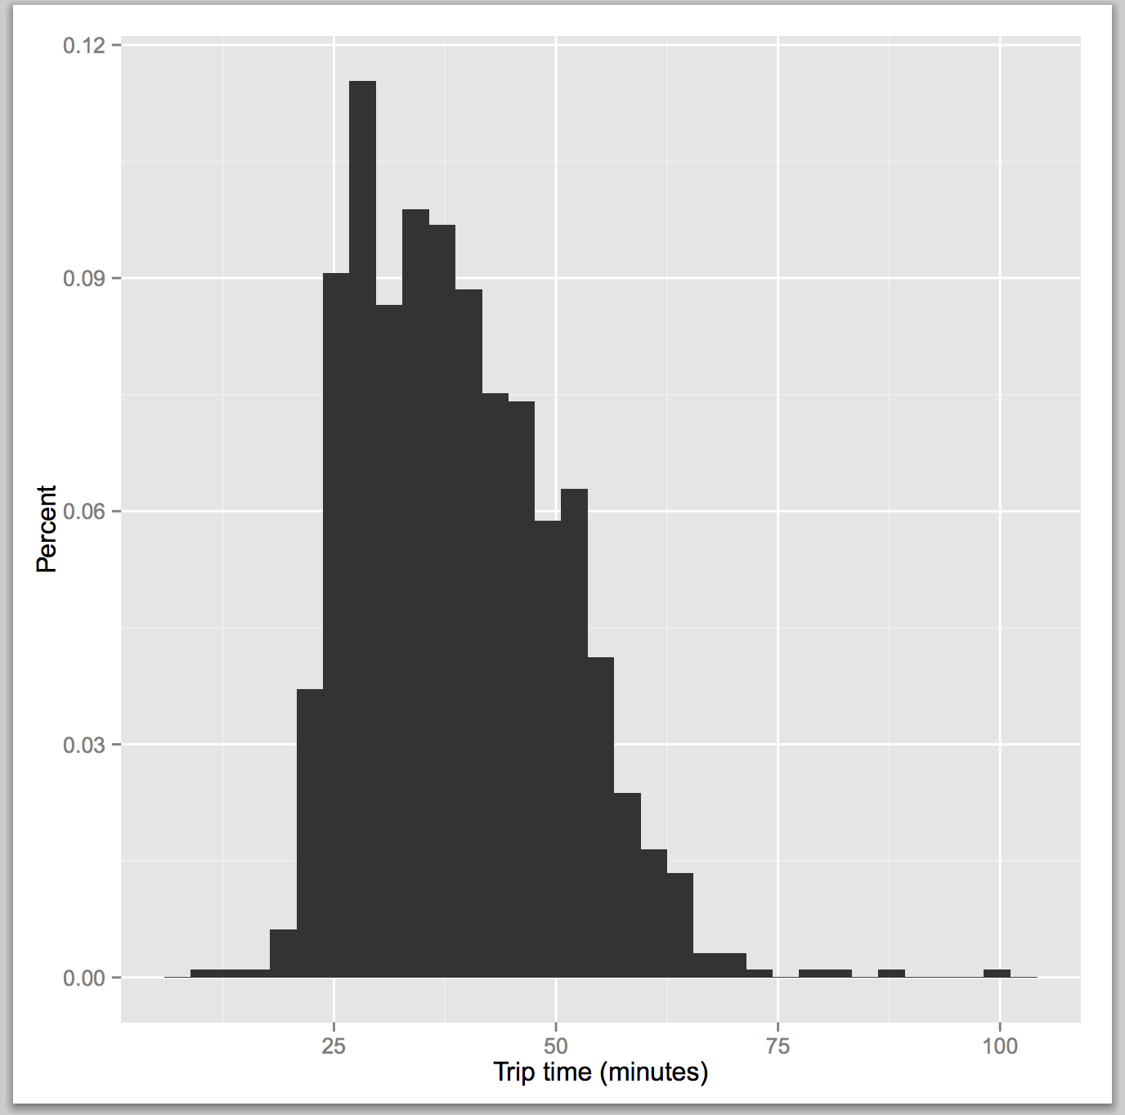
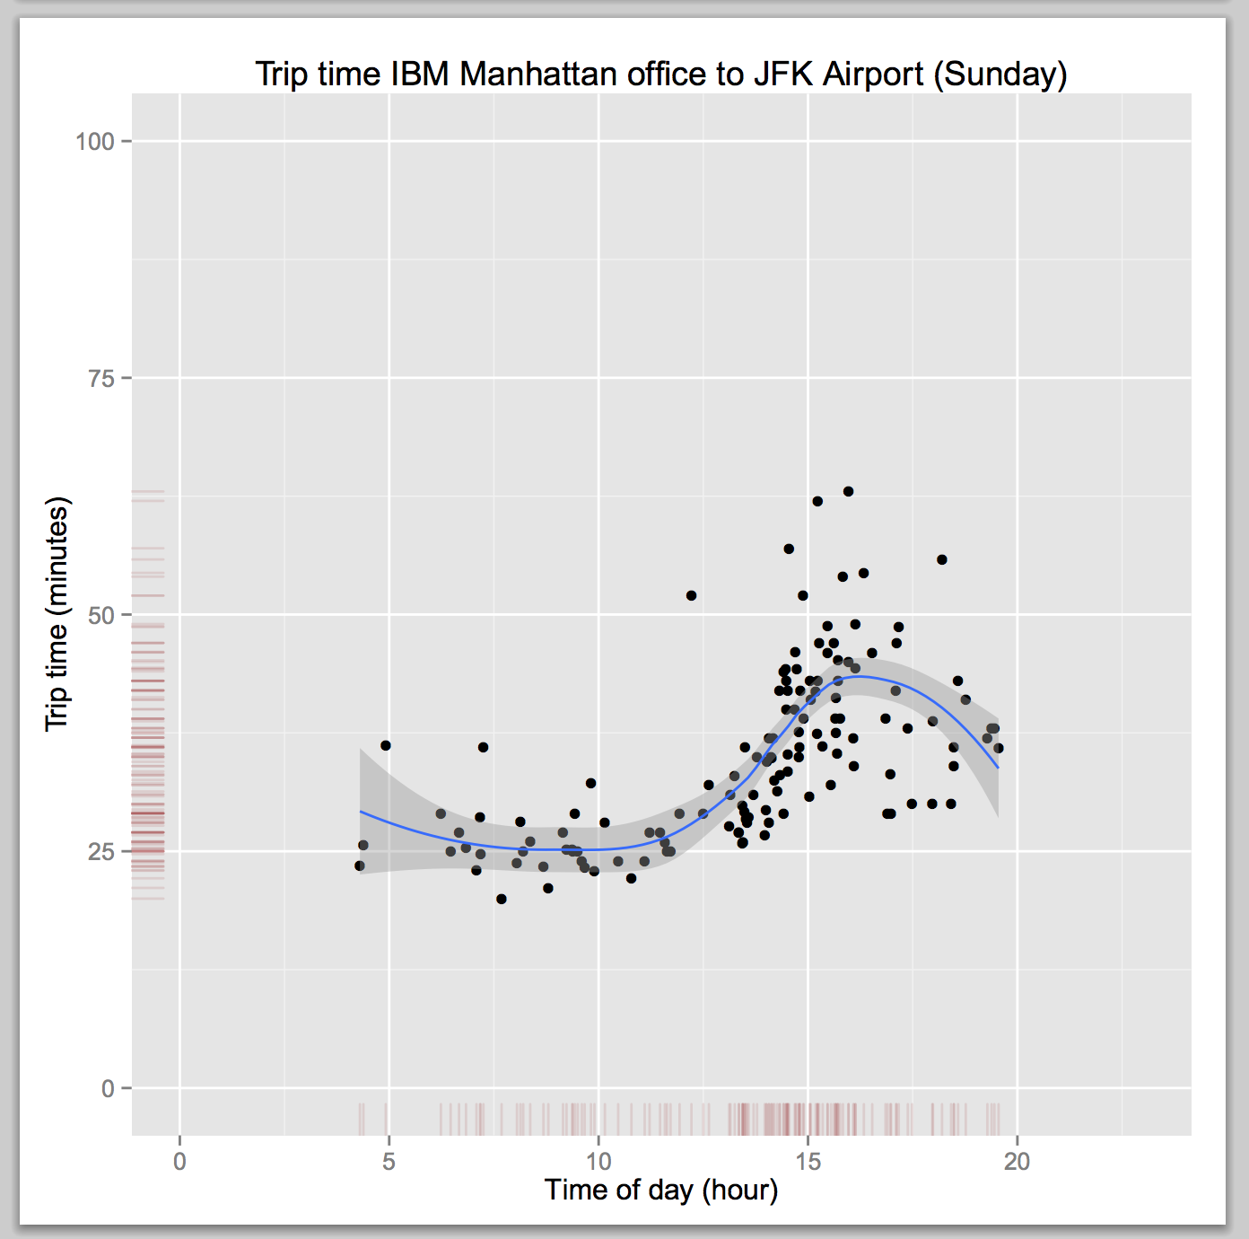

Slide 28
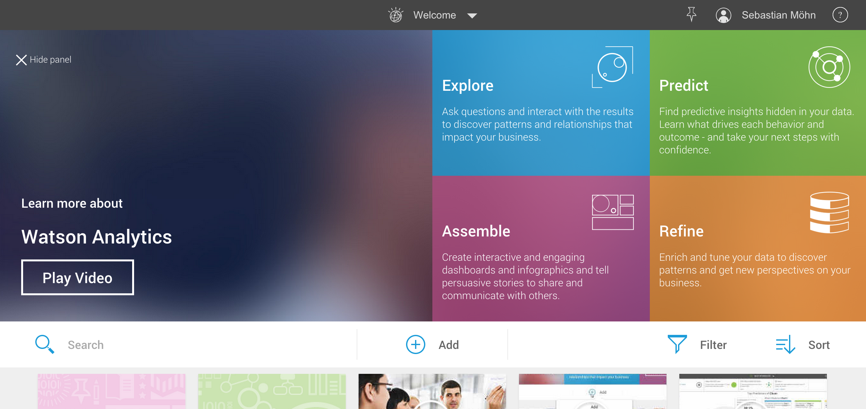

Slide 29
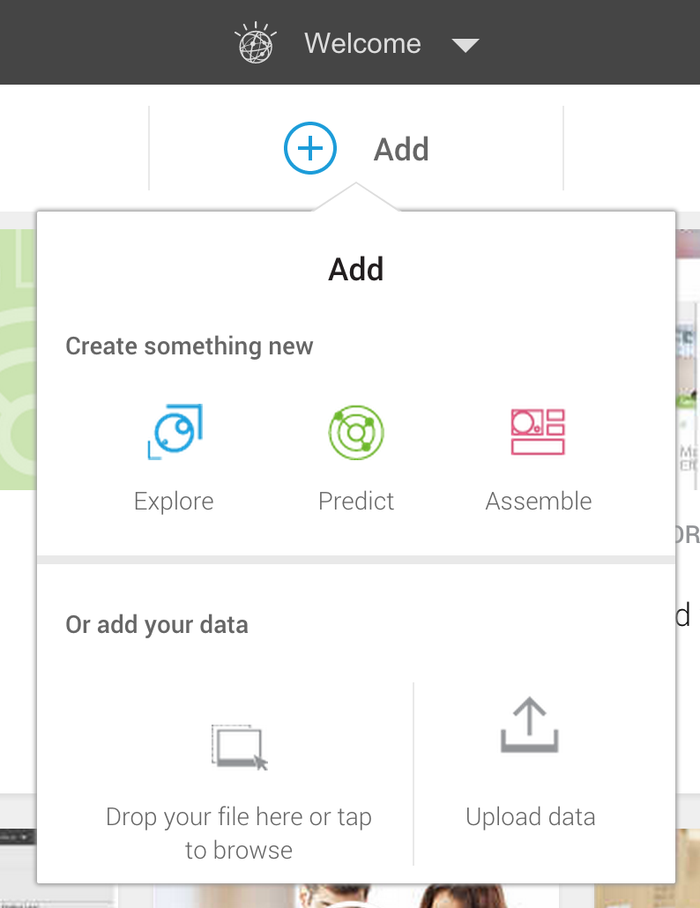
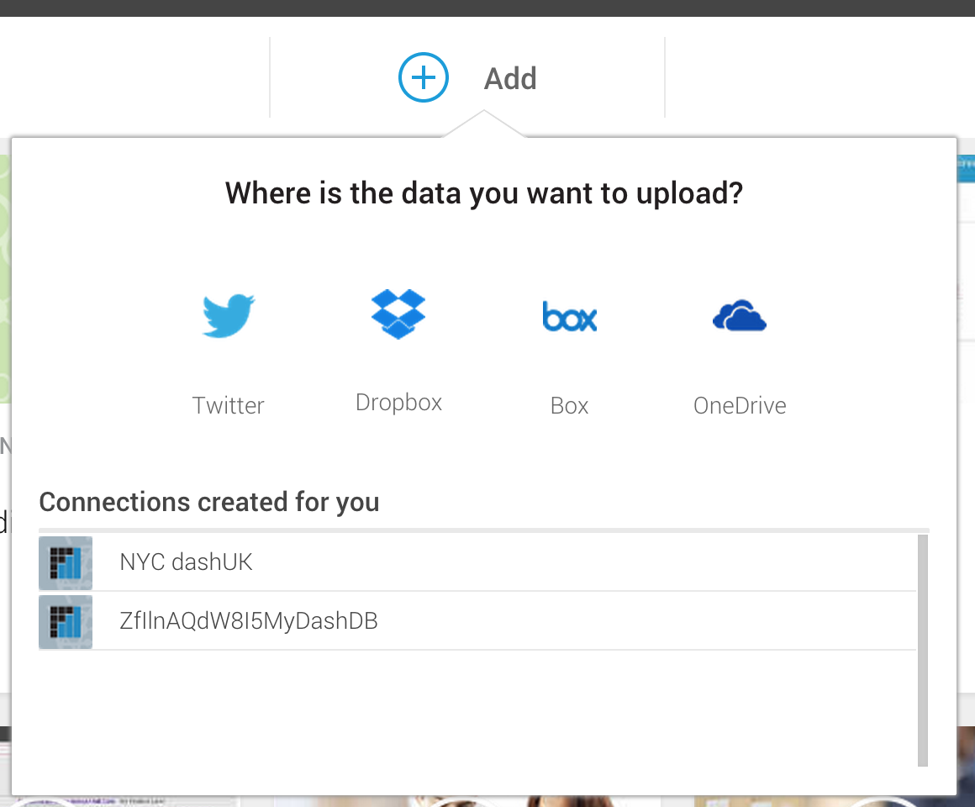

Slide 30
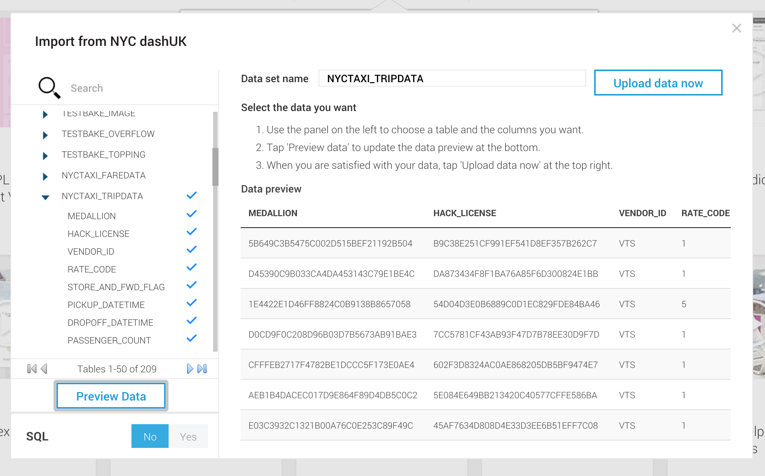
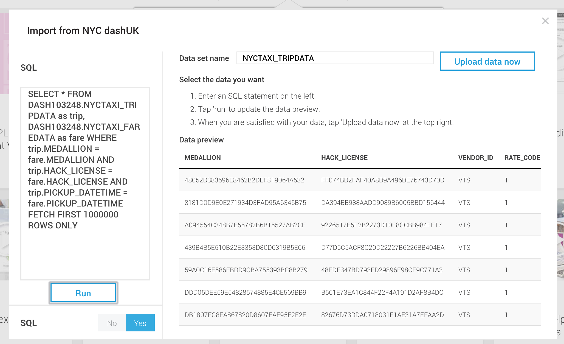

Slide 31
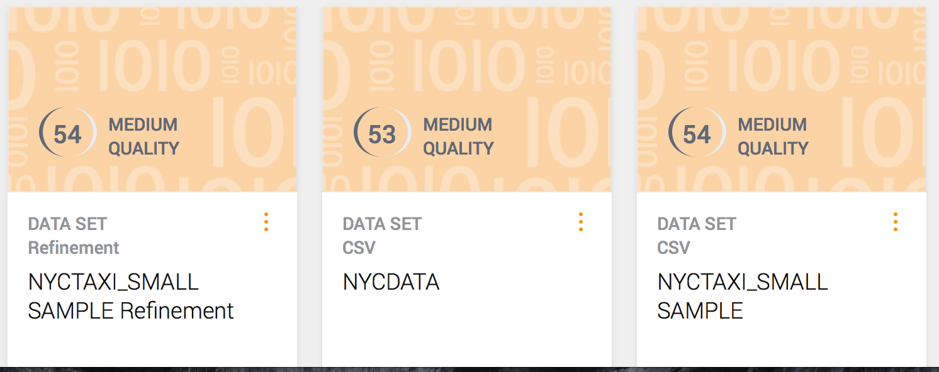

Slide 32
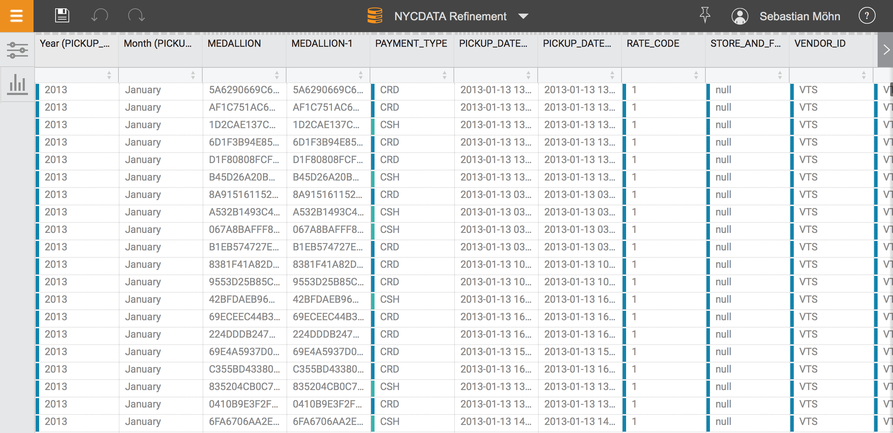

Slide 33
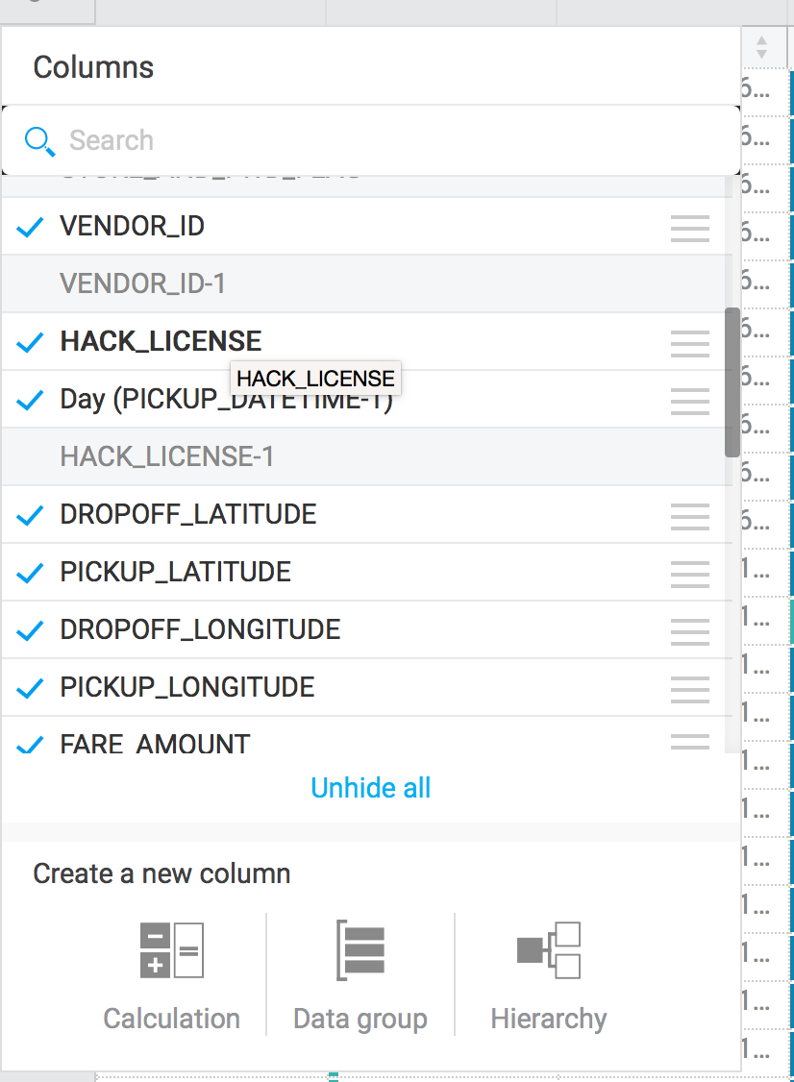
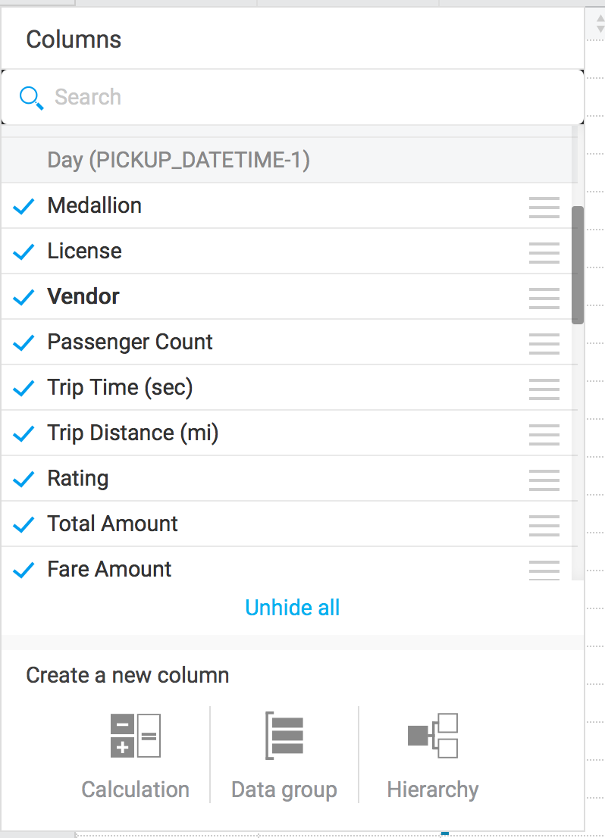

Slide 34
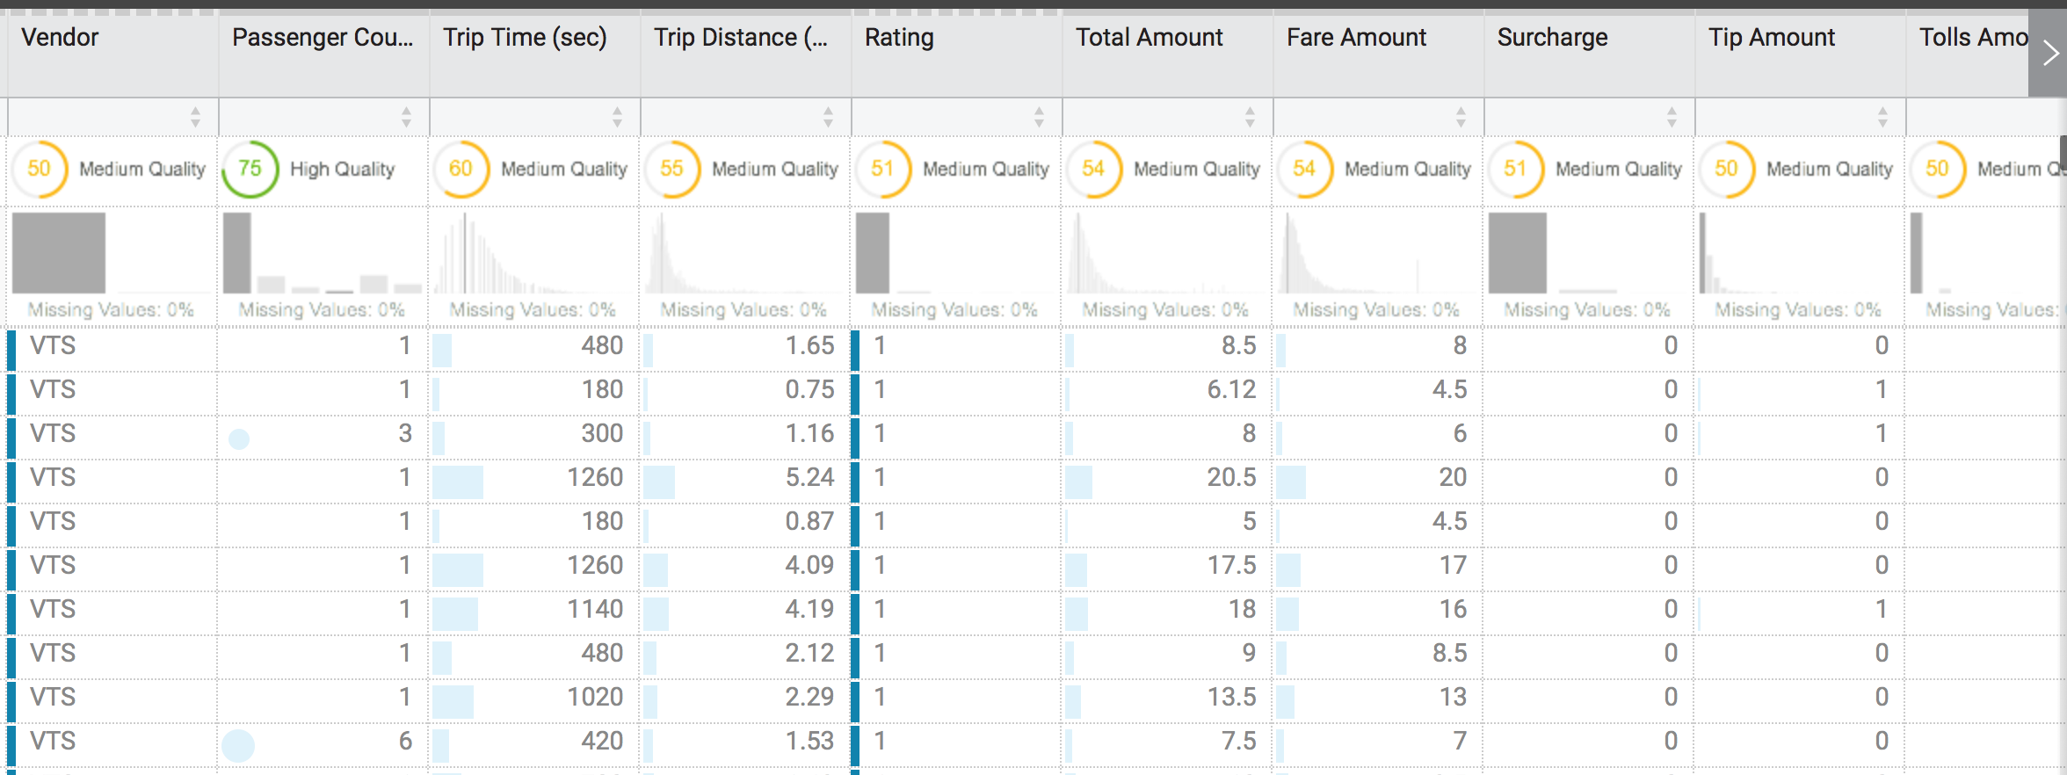

Slide 35
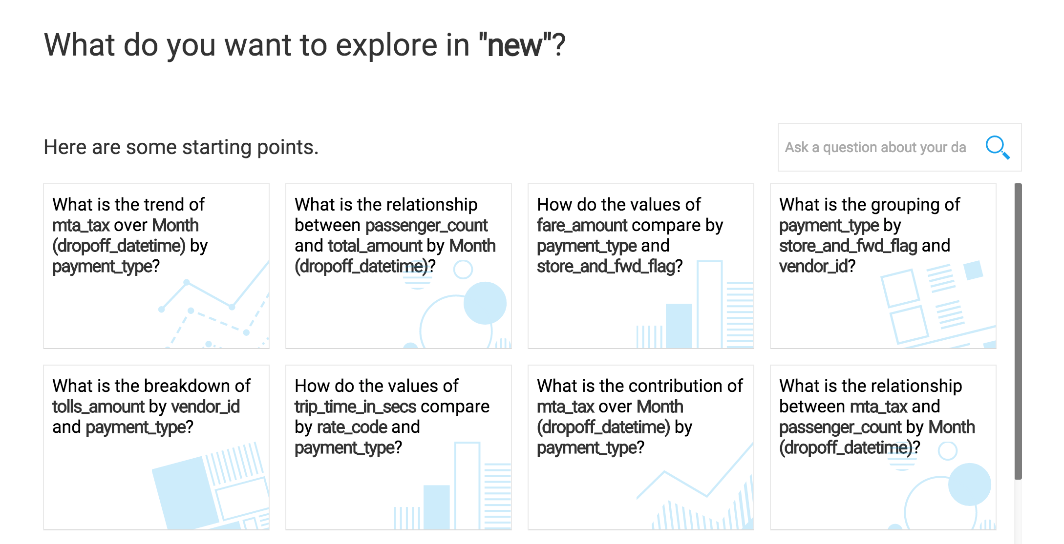

Slide 36
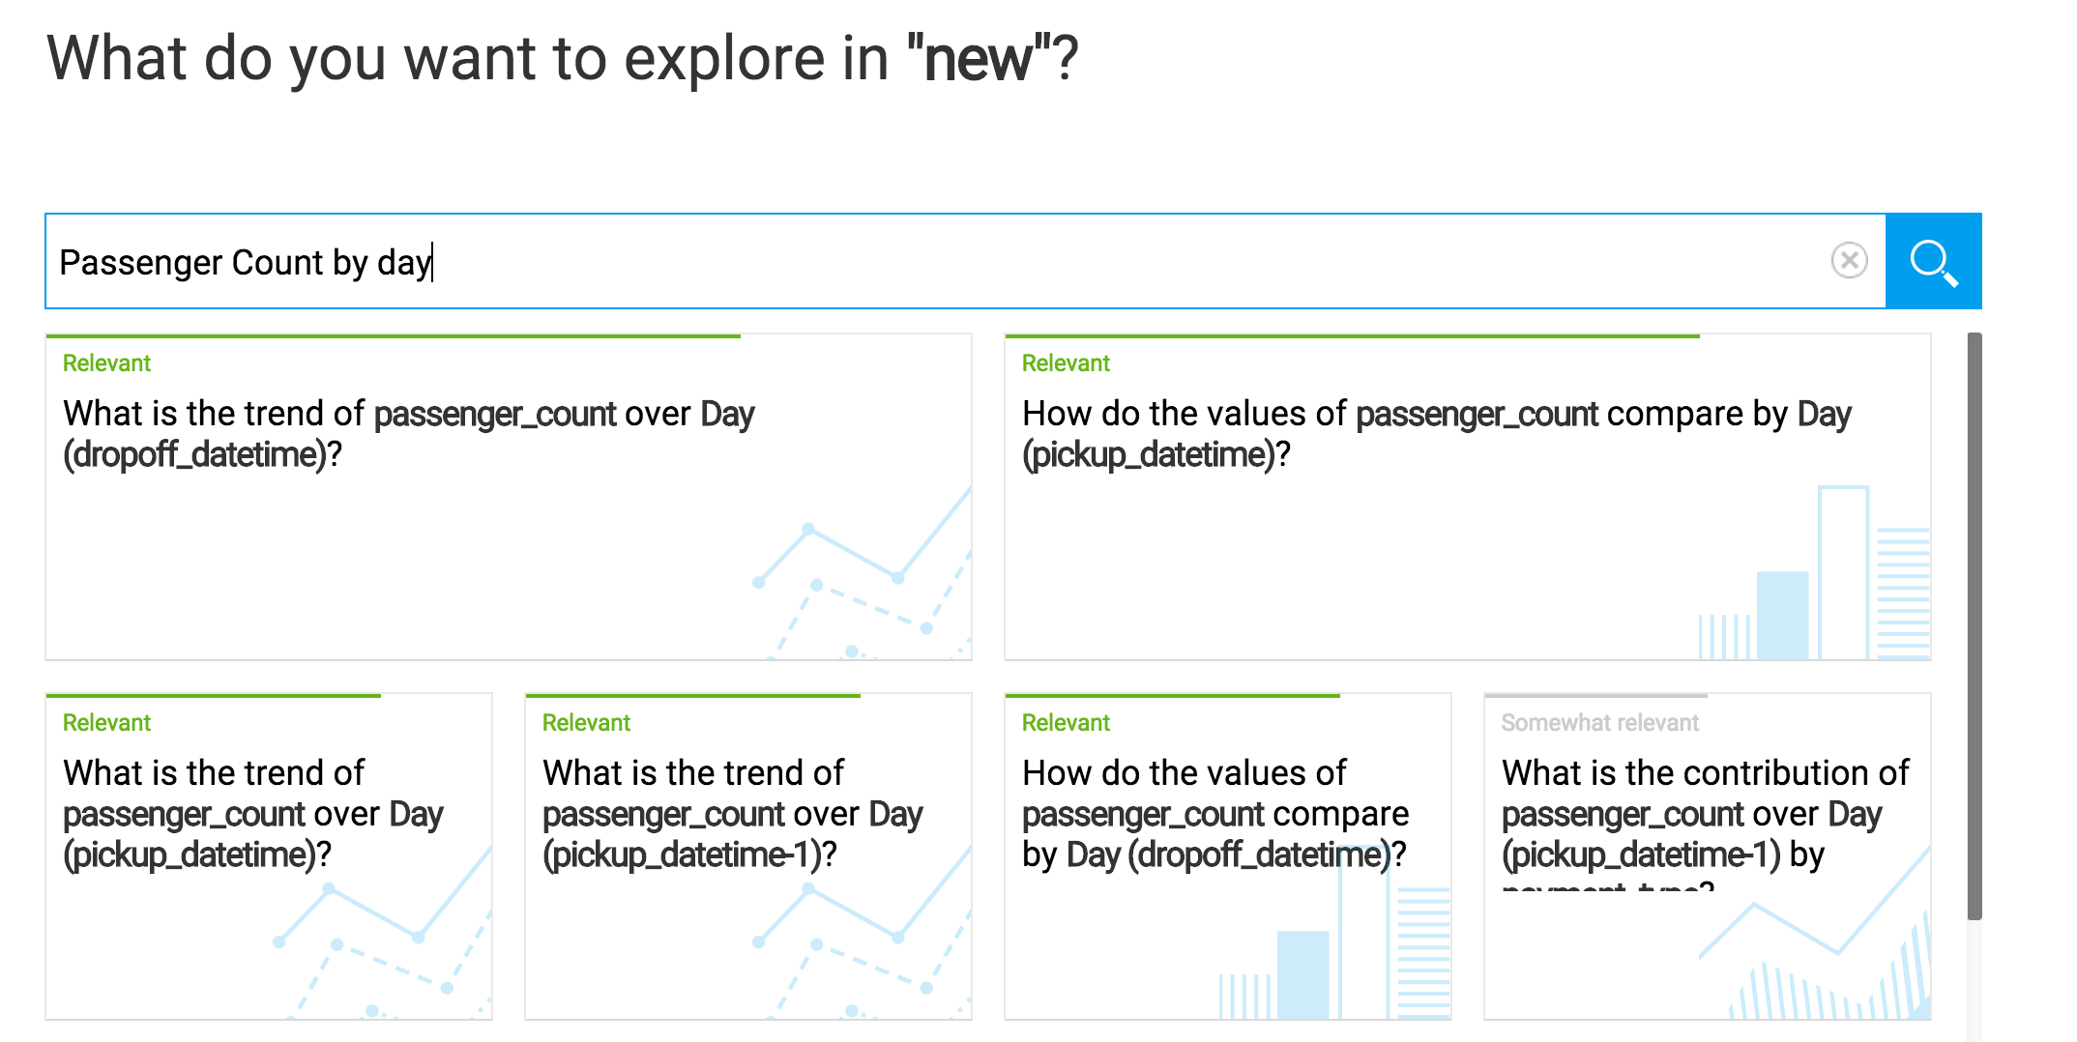

Slide 37
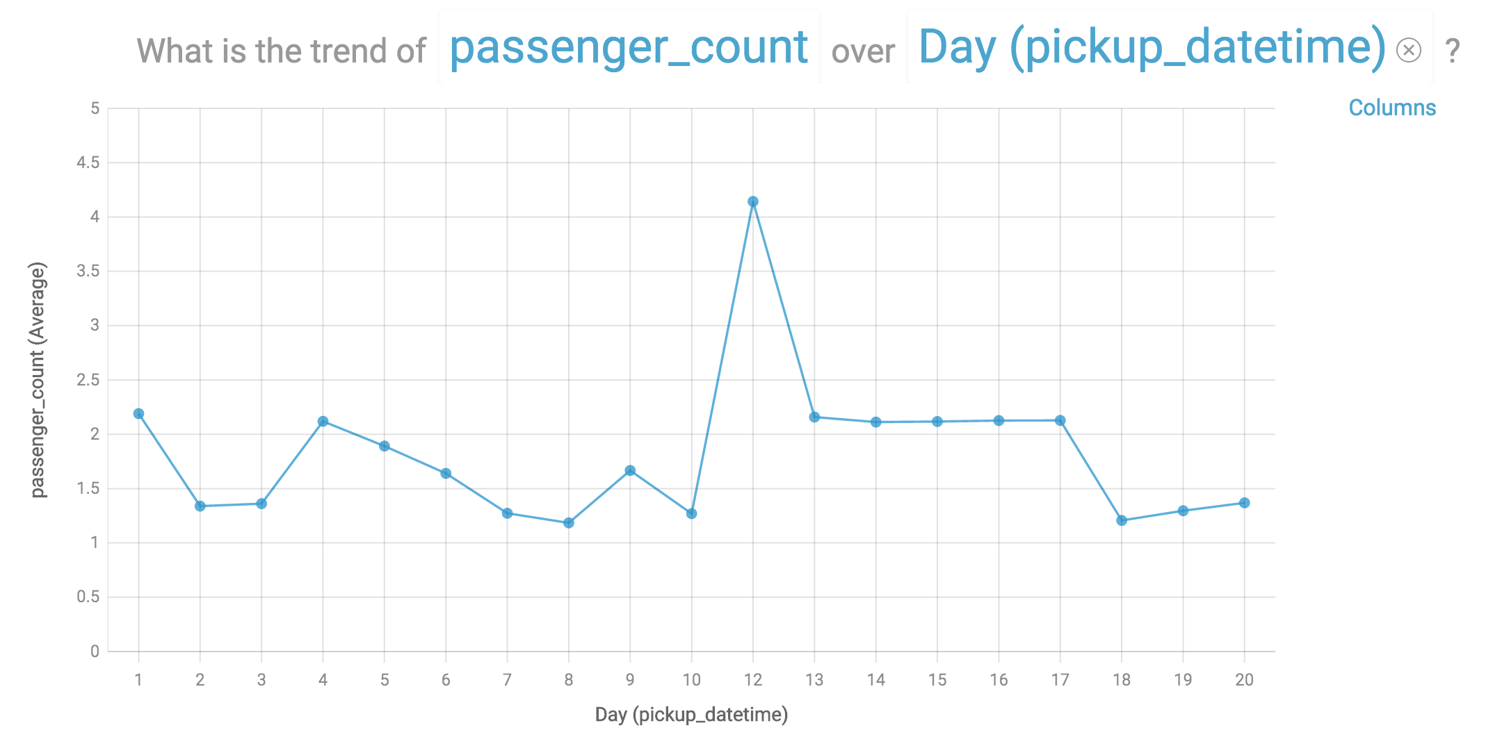

Slide 38
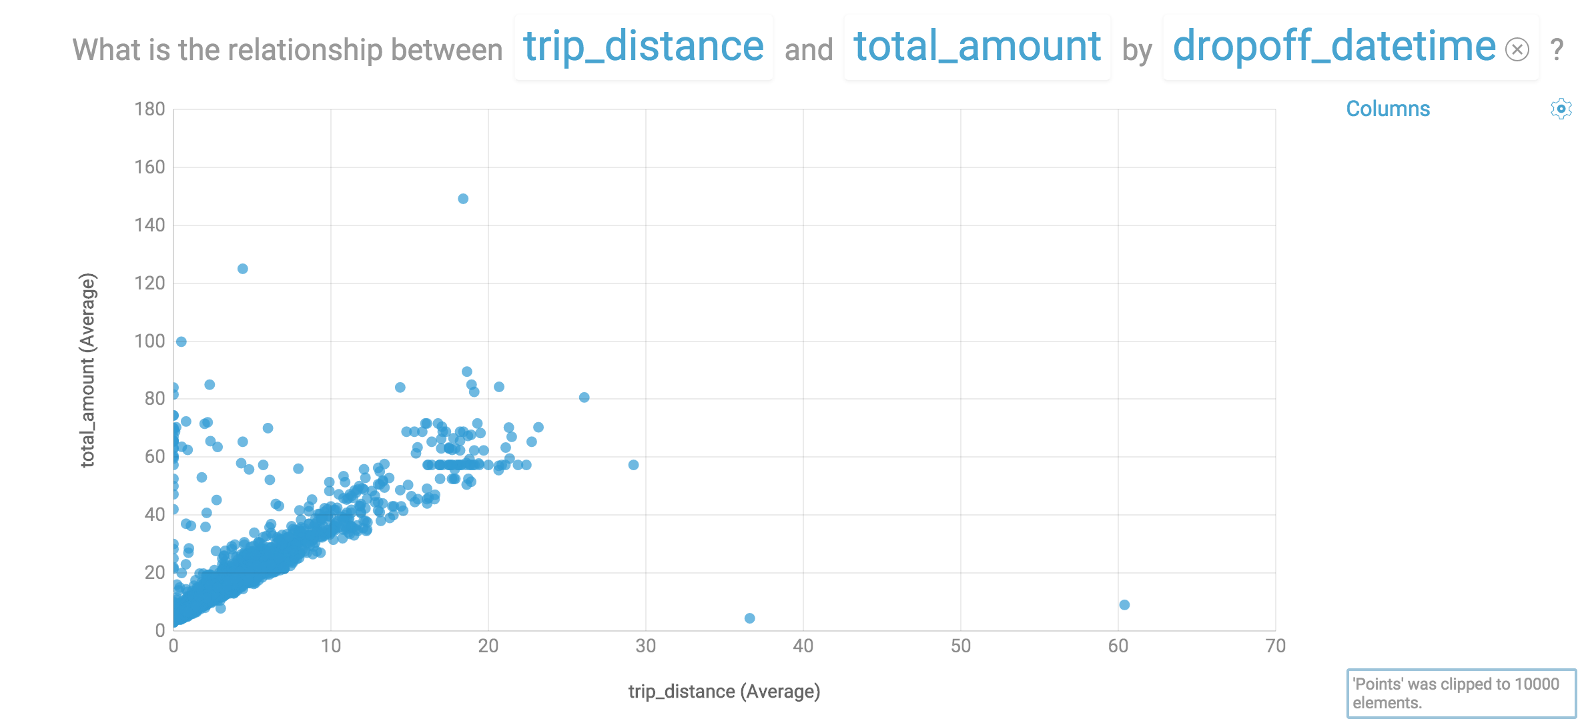

Slide 39
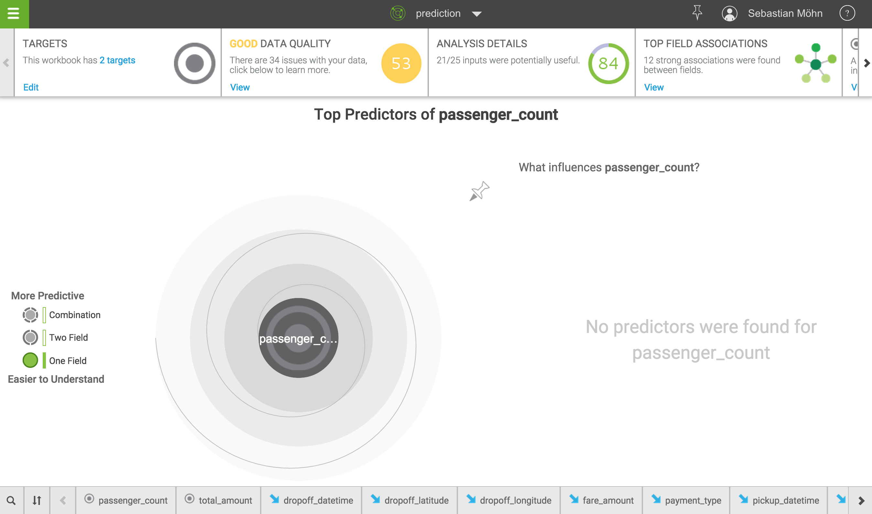

Slide 40
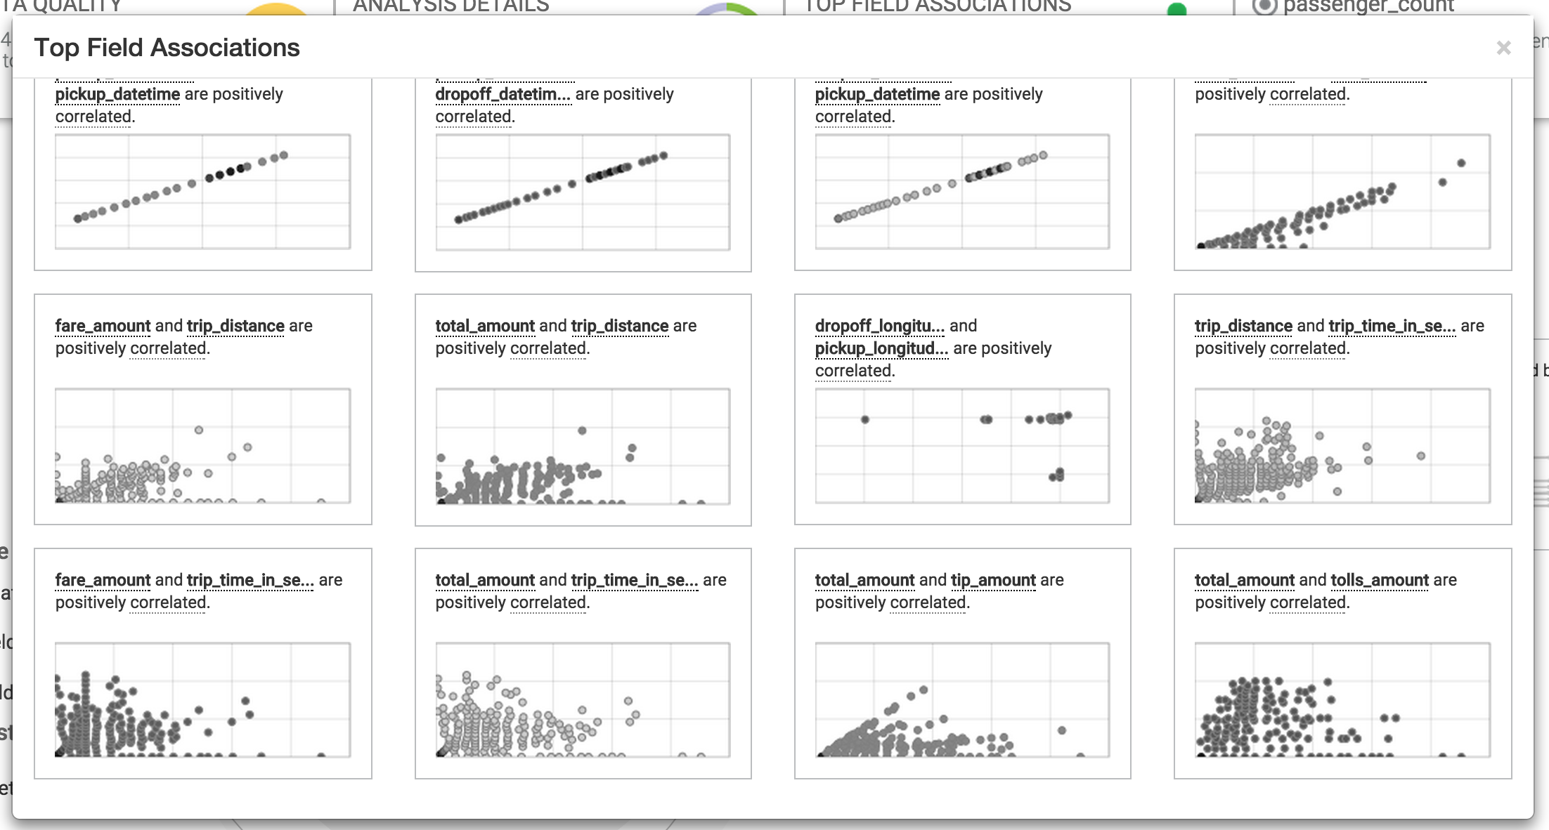

Slide 41
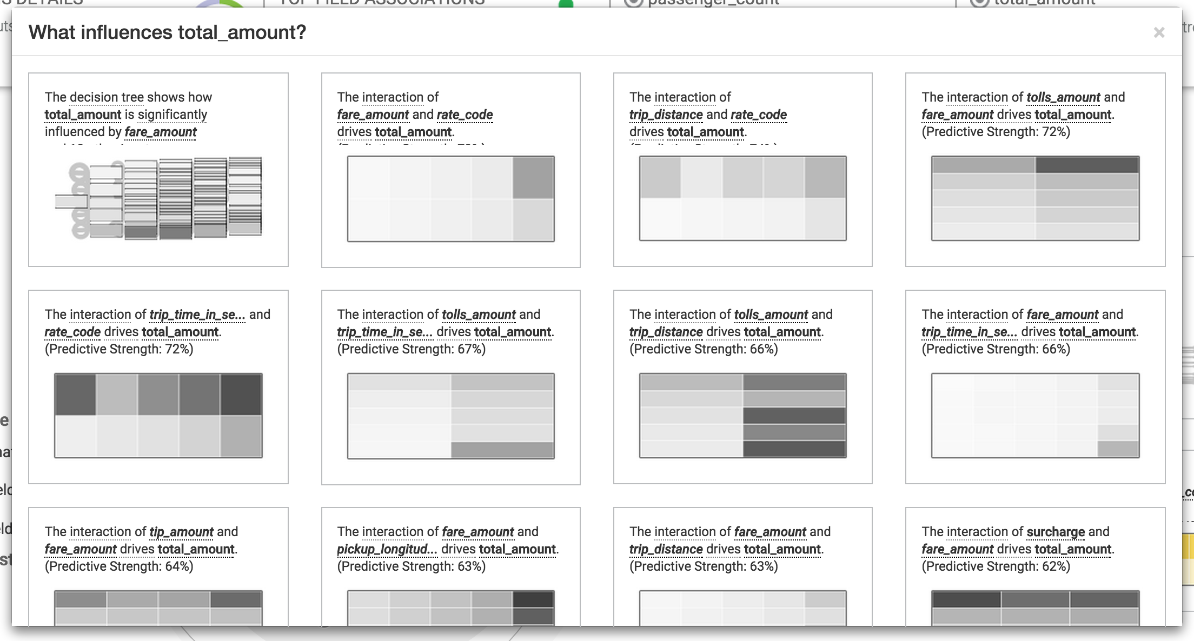

Slide 42
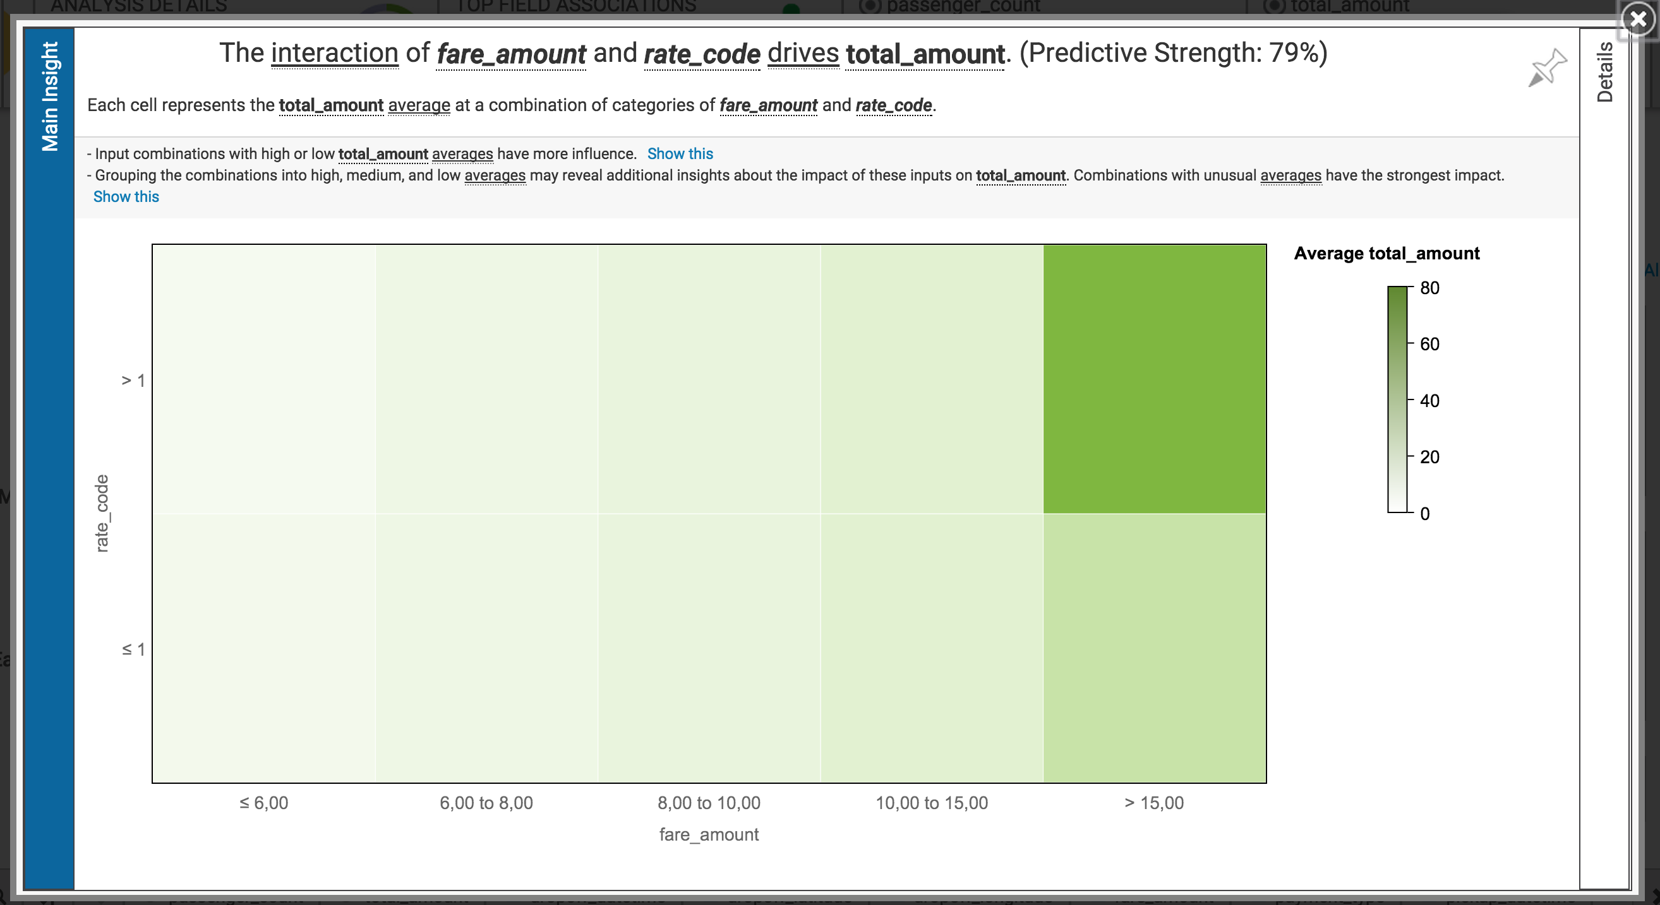

Slide 43
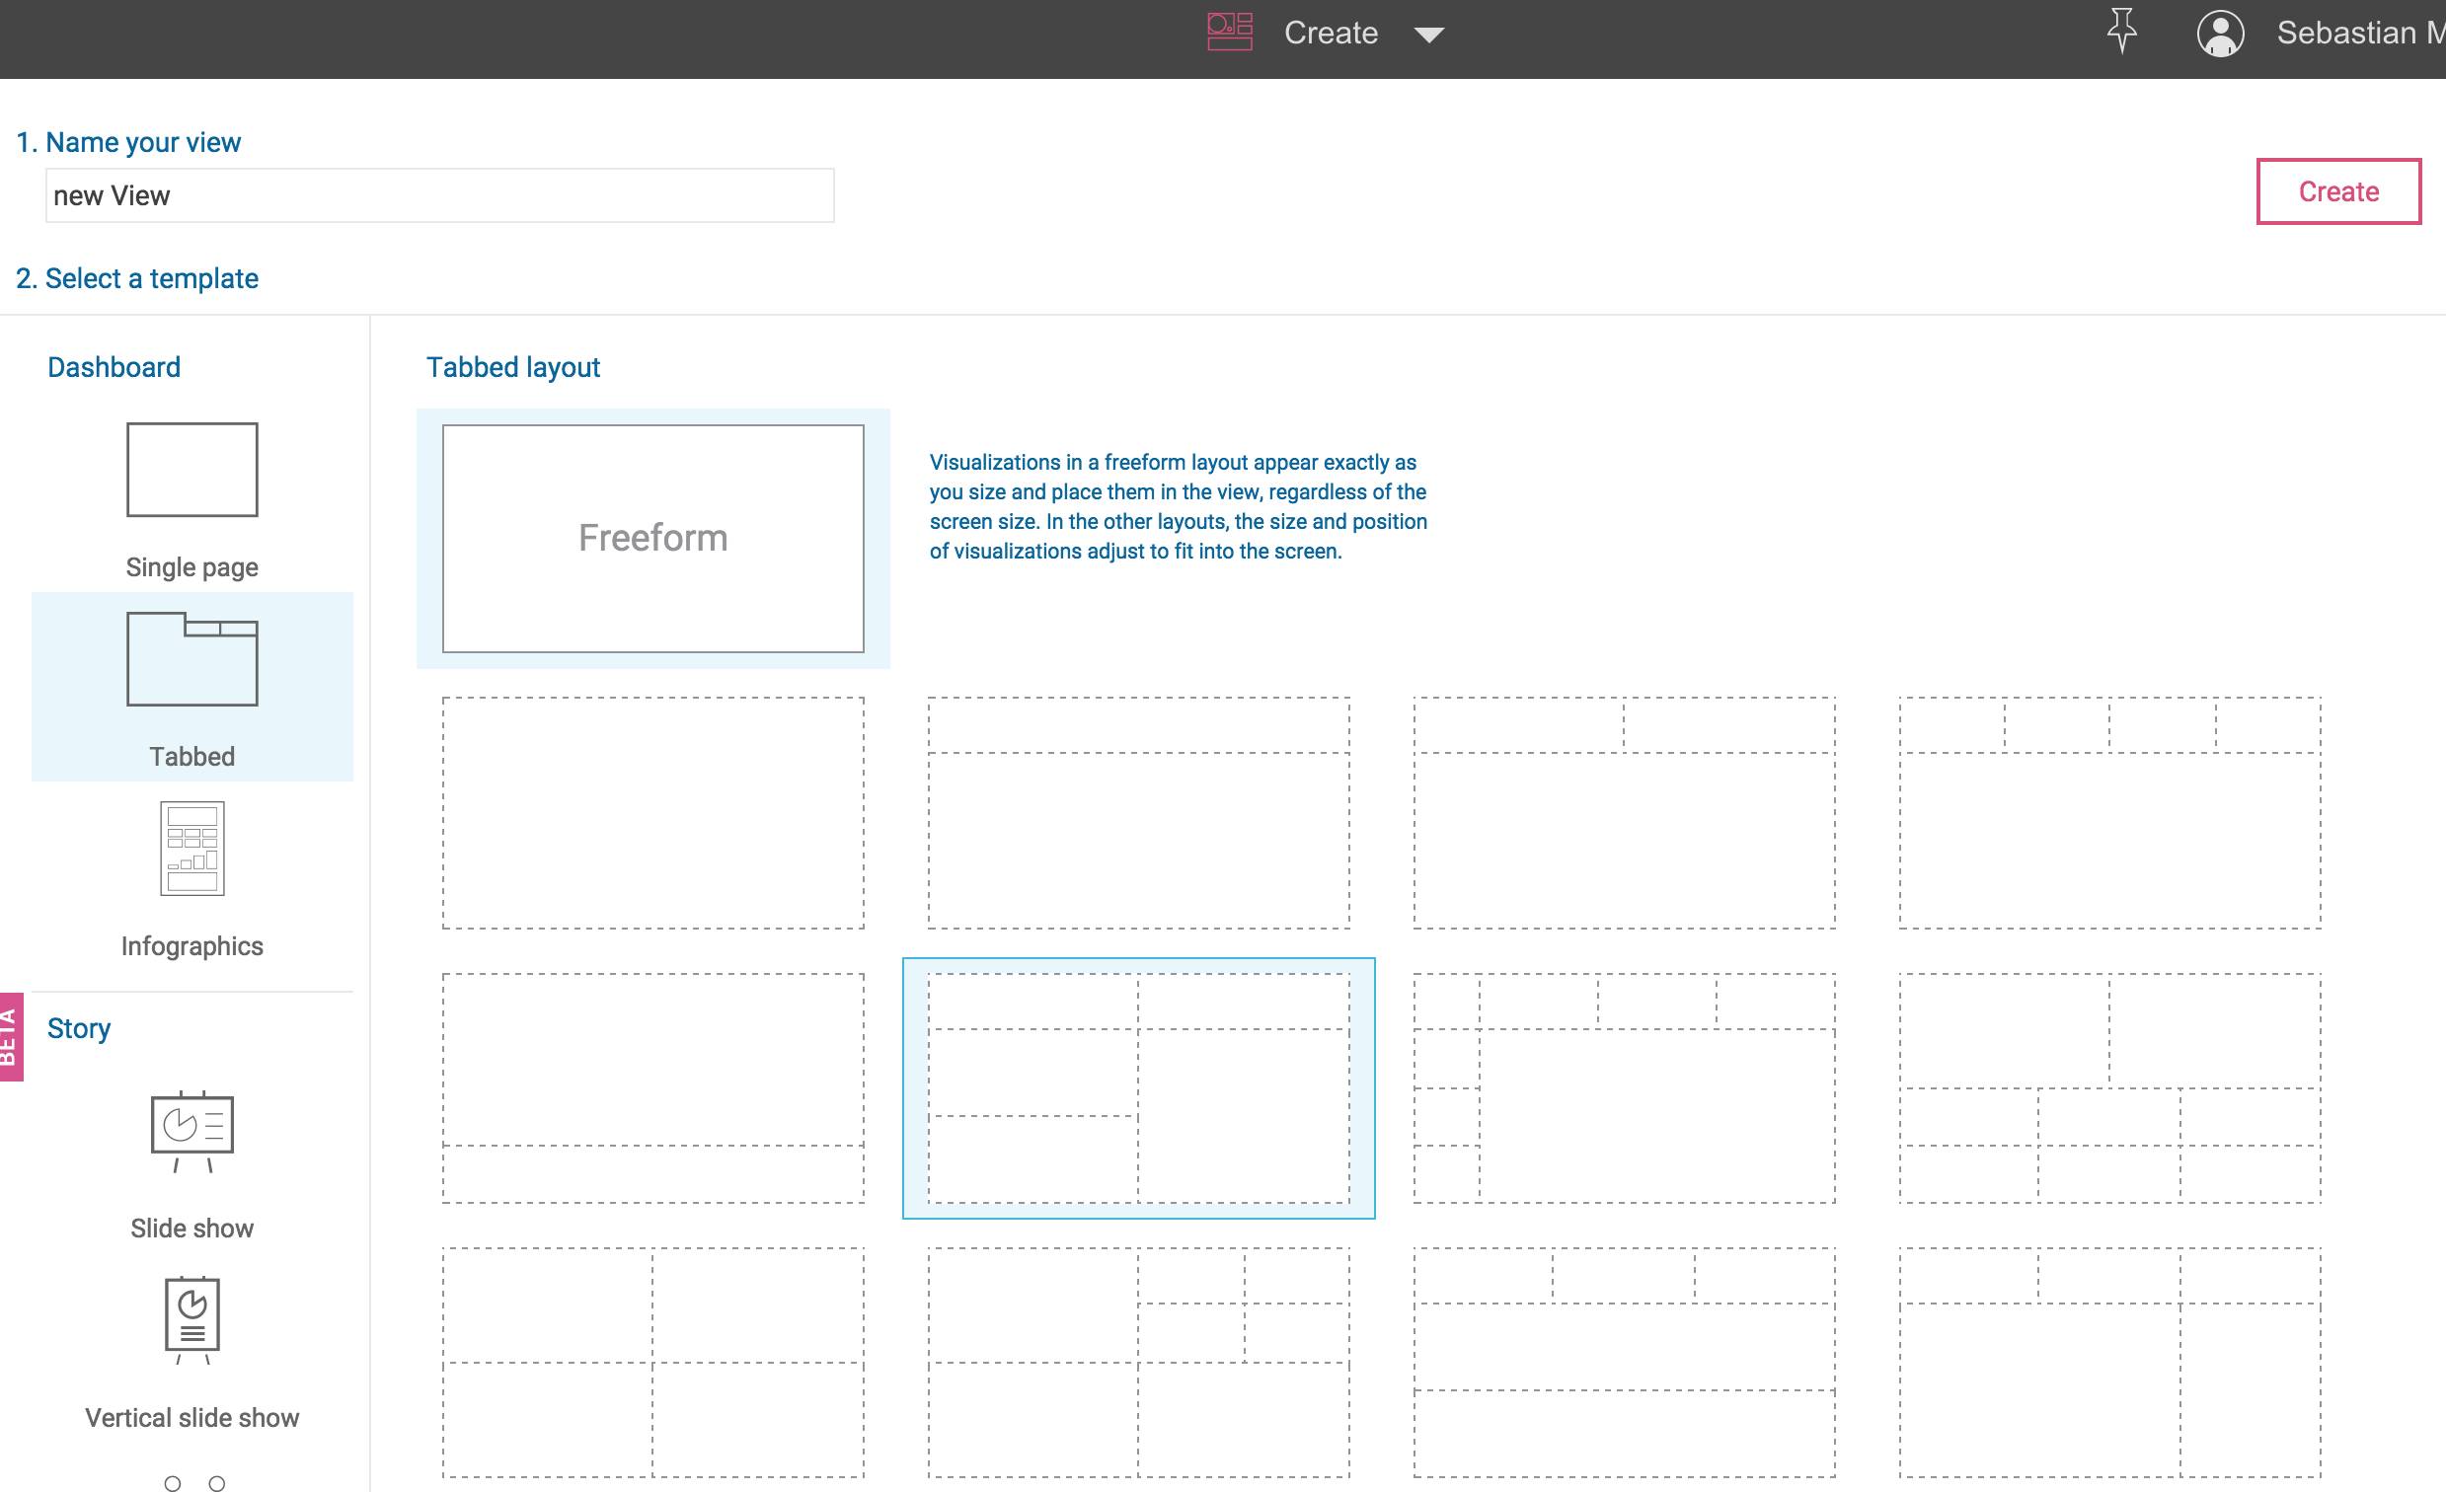

Slide 44
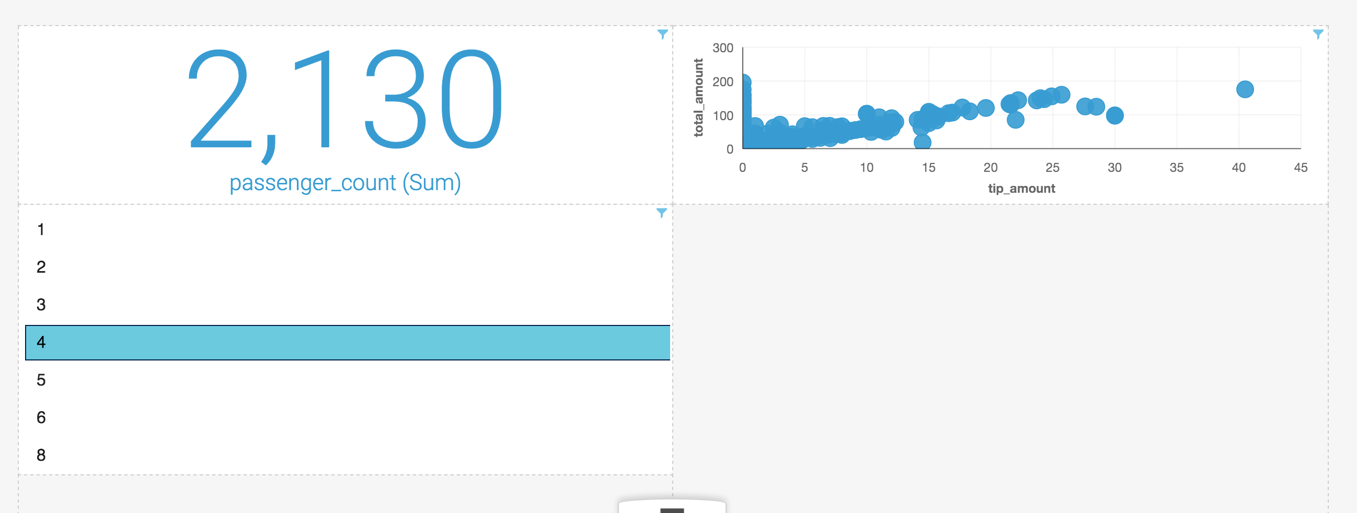

Slide 45
